Slide 1



©2023 Otsuka Pharmaceutical Development & Commercialization, Inc. All rights reserved. November 2023 00US23EUA0008
Notes:
©2023 Otsuka Pharmaceutical Development & Commercialization, Inc. All rights reserved. November 2023 00US23EUA0008

Slide 2
Table Of Contents
Executive Summary
U.S. Health Care Coverage, By Payer Type, 2011-2022
Insured Population In Managed Care Plans, By Payer Type, 2011-2020
Health Insurance Coverage & The SMI Population, By Payer Type, 2016-2022
Number Of Psychiatric Hospital Beds In The U.S., 2016-2022
State-By-State Overview Of Psychiatric Beds
Alternative Payment Models, Distribution of Healthcare Payments By Model Type, 2018-2022
Behavioral Health Workforce Supply & Demand, 2023-2035
HEDIS Behavioral Health Measures: The OPEN MINDS Composite Mental & Behavioral Health Score, By Payer Type, 2017-2021
HEDIS Behavioral Health Measures: Depression: Adhering To Medication For 12 Weeks, By Payer Type, 2017-2021
Follow-Up After Hospitalization For Mental Illness, By Payer Type, 2014-2021
HEDIS Behavioral Health Measures: Alcohol Or Drug Dependence Treatment Initiated, By Payer Type, 2017-2021
HEDIS Behavioral Health Measures: Diabetes Screening For People With Schizophrenia Or Bipolar Disorder Who Are Using Antipsychotic Medications, Medicaid HMO Payers, 2017-2021
HEDIS Behavioral Health Measures: Follow-Up After ADHD Initial Treatment, By Payer Type, 2017-2021
HEDIS Behavioral Health Measures: Diabetes Monitoring For People With Diabetes & Schizophrenia, Medicaid HMO Payers, 2017-2021
HEDIS Behavioral Health Measures: Adherence To Antipsychotic Medications For Individuals With Schizophrenia, By Payer Type, 2017-2021
HEDIS Behavioral Health Measures: Cholesterol & Blood Sugar Testing For Youth On Antipsychotic Medication, By Payer Type, 2017-2021
HEDIS Behavioral Health Measures: First-Line Psychosocial Care For Youth On Antipsychotic Medications, By Payer Type, 2017-2021
Notes:
©2023 Otsuka Pharmaceutical Development & Commercialization, Inc. All rights reserved. November 2023 00US23EUA0008

Slide 3
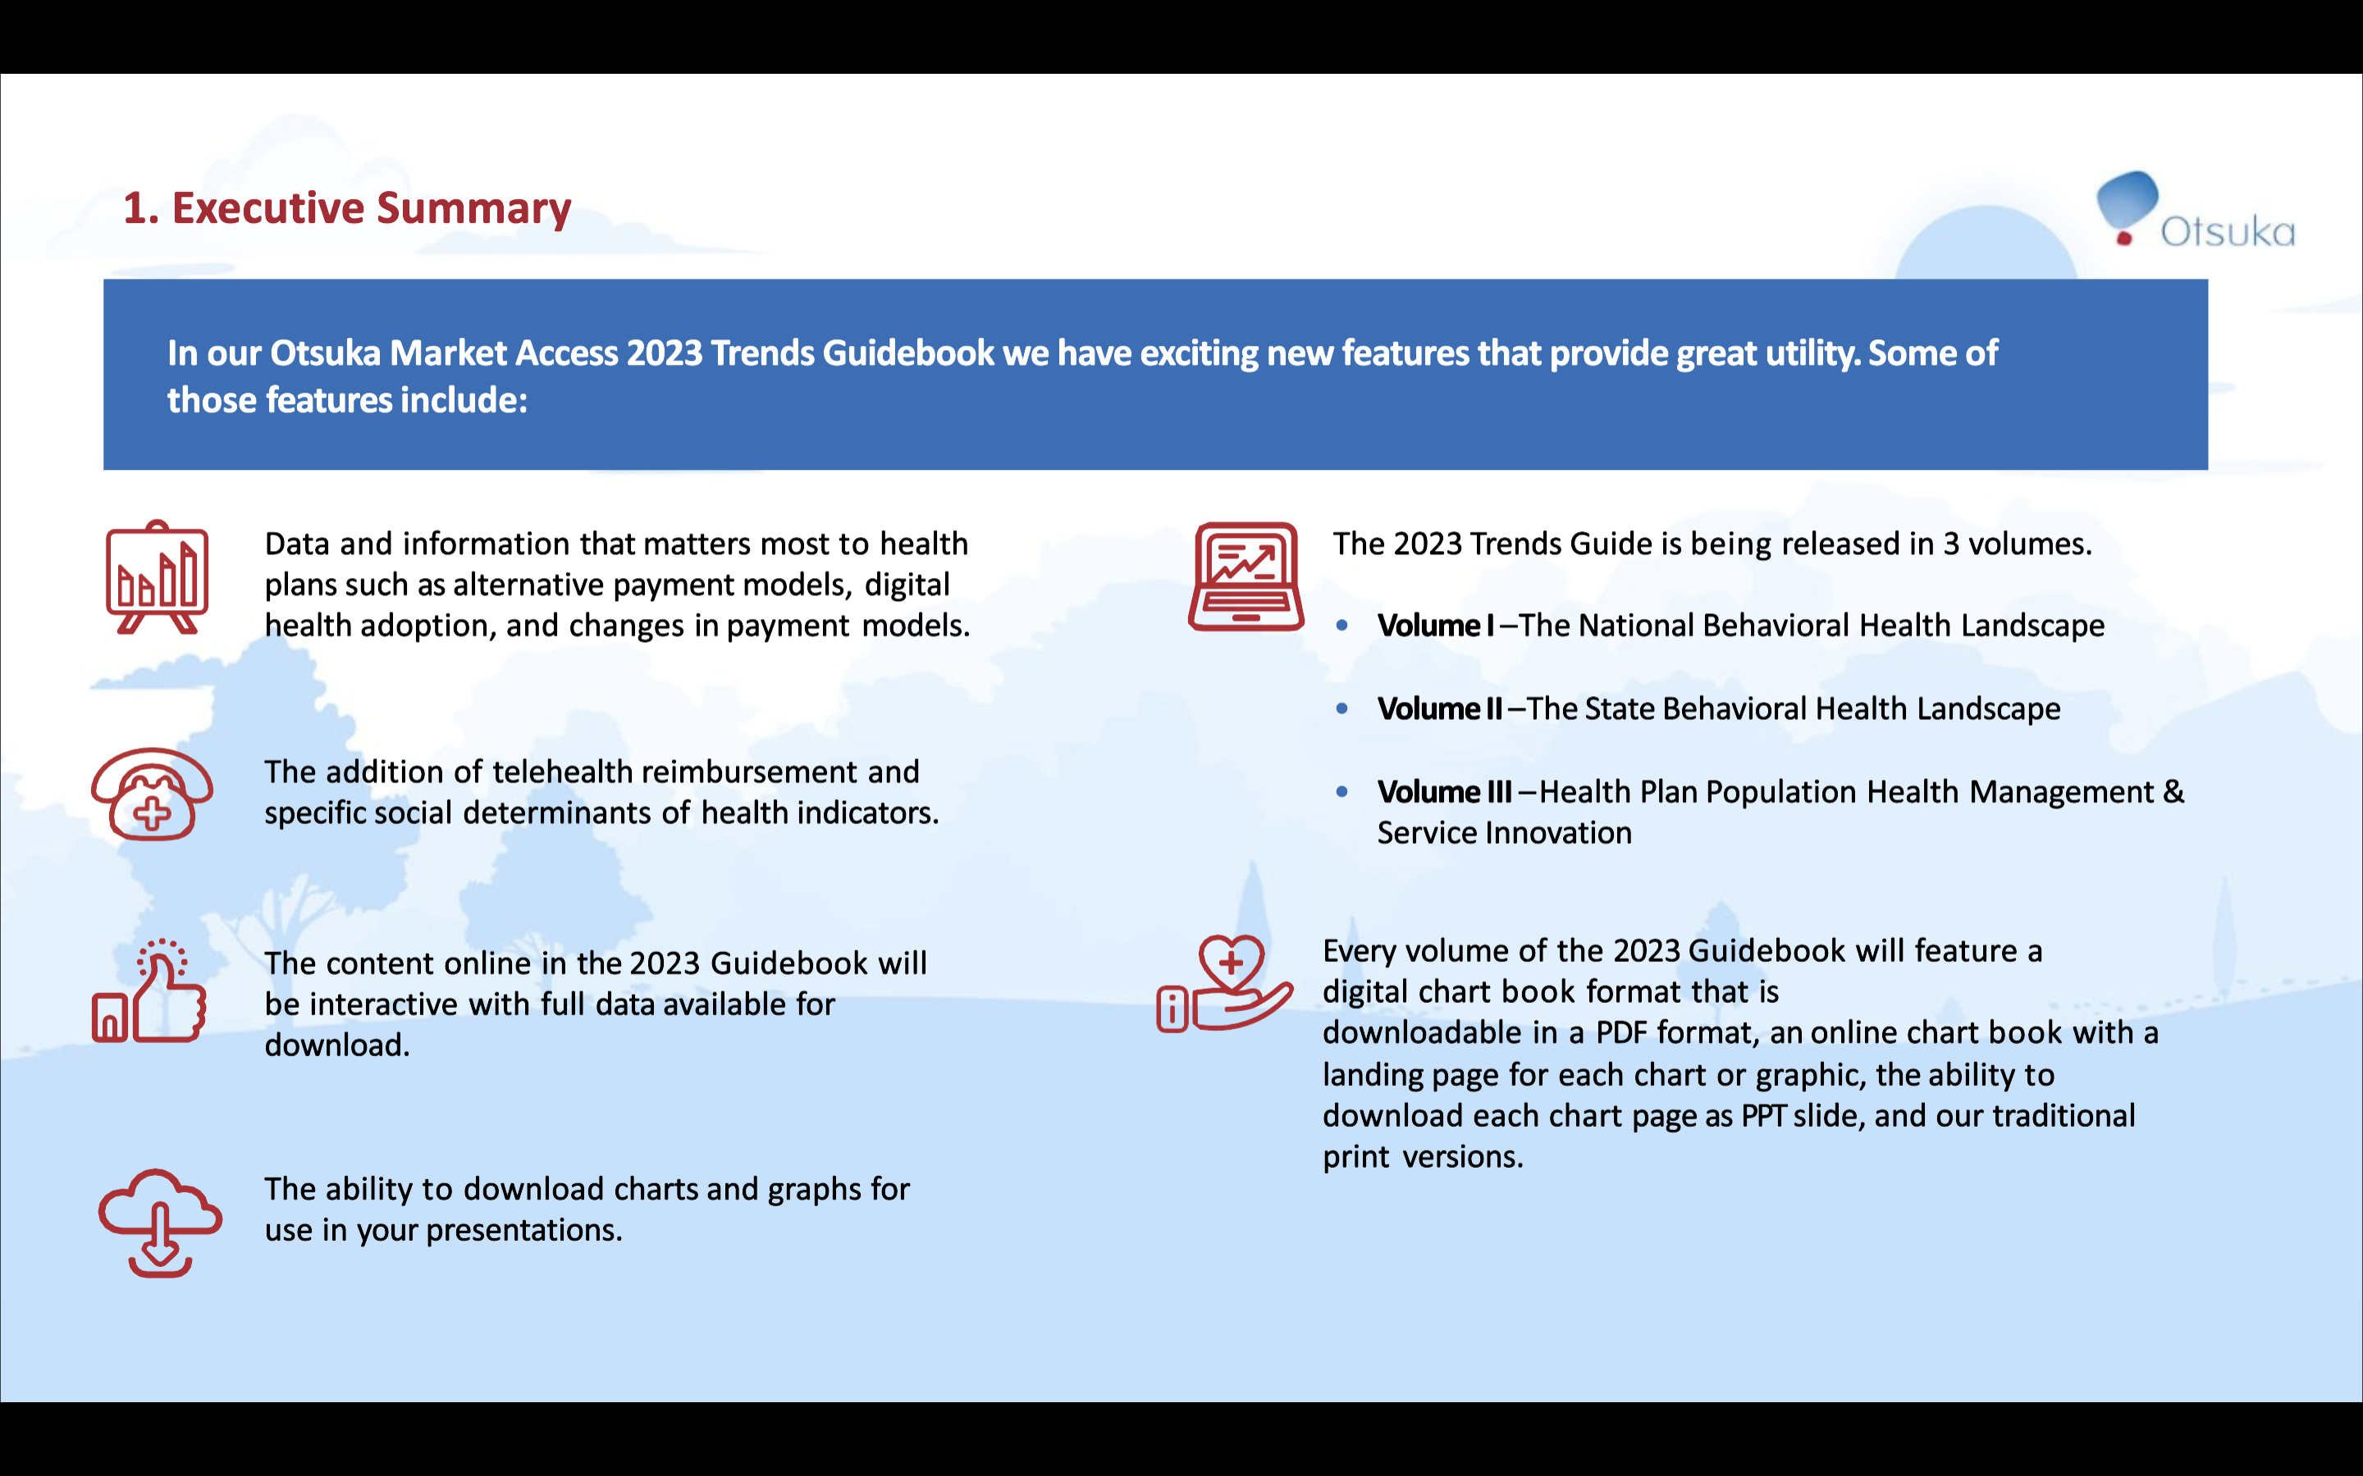

Slide 4


Slide 5


Slide 6
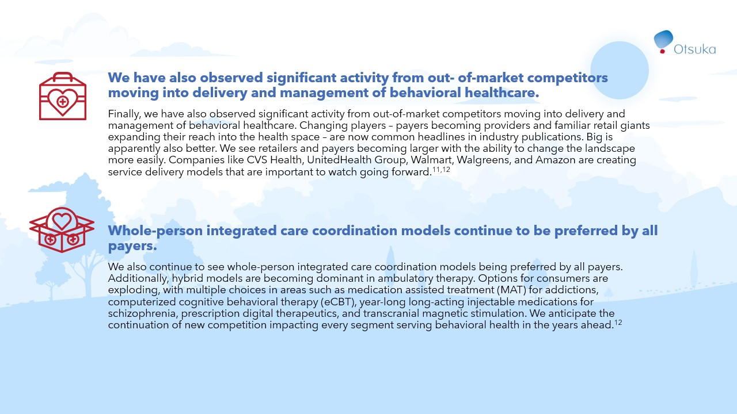

Slide 7
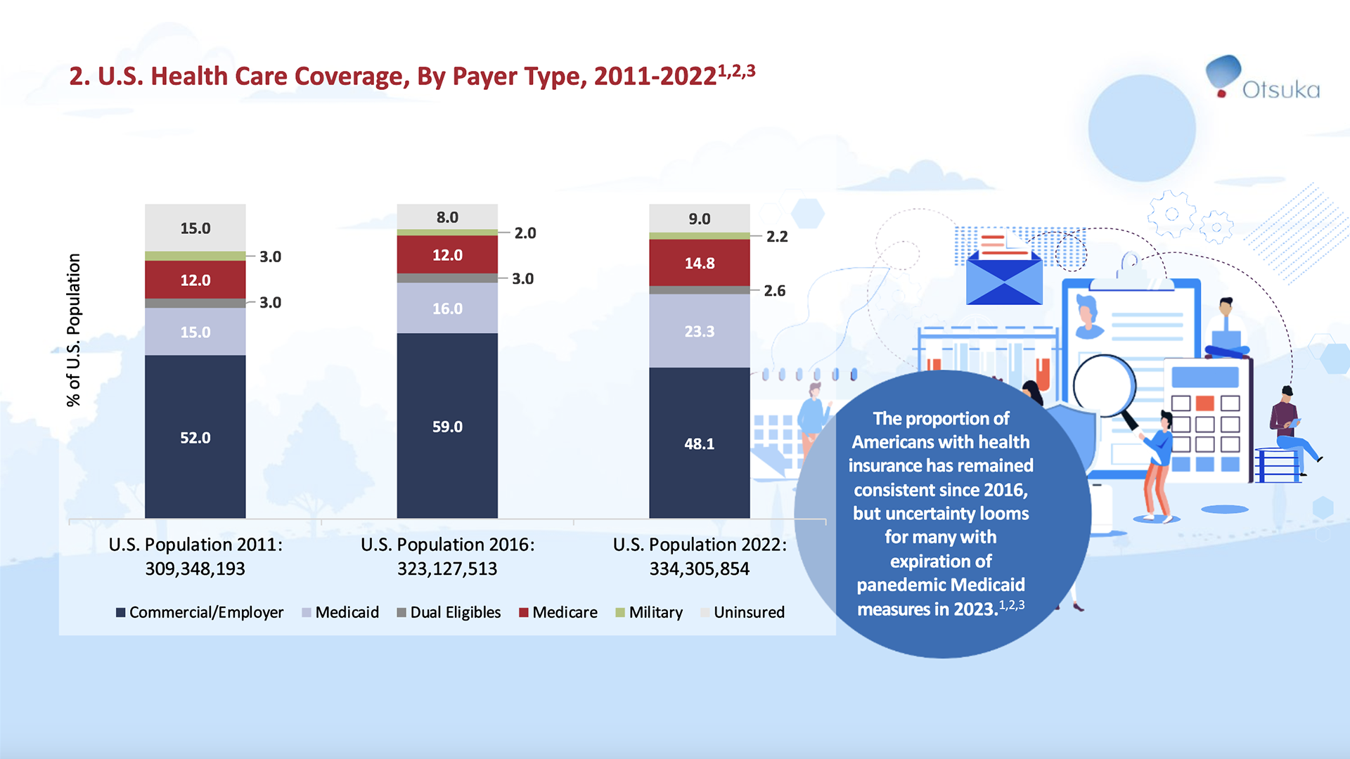

Slide 8
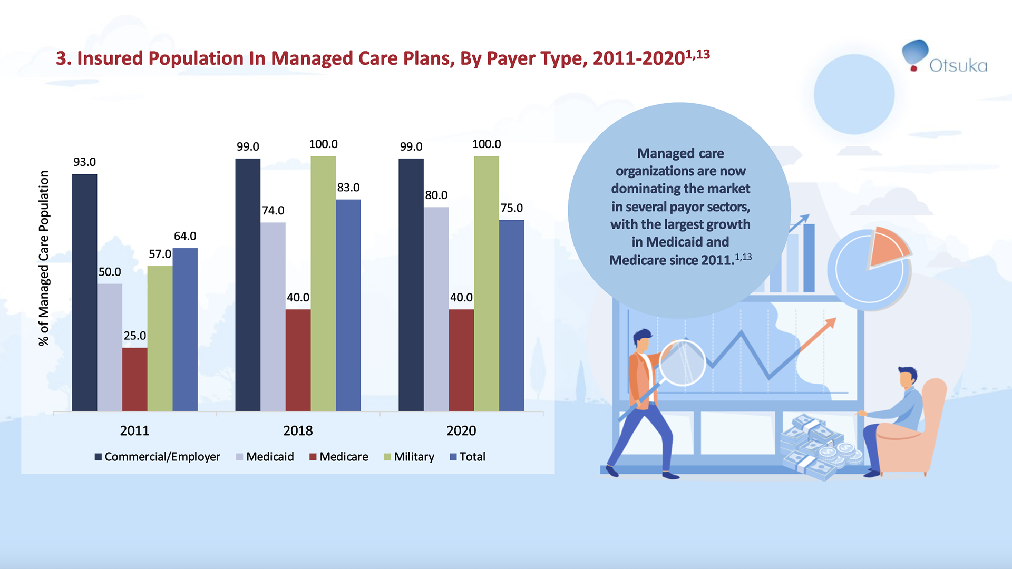

Slide 9
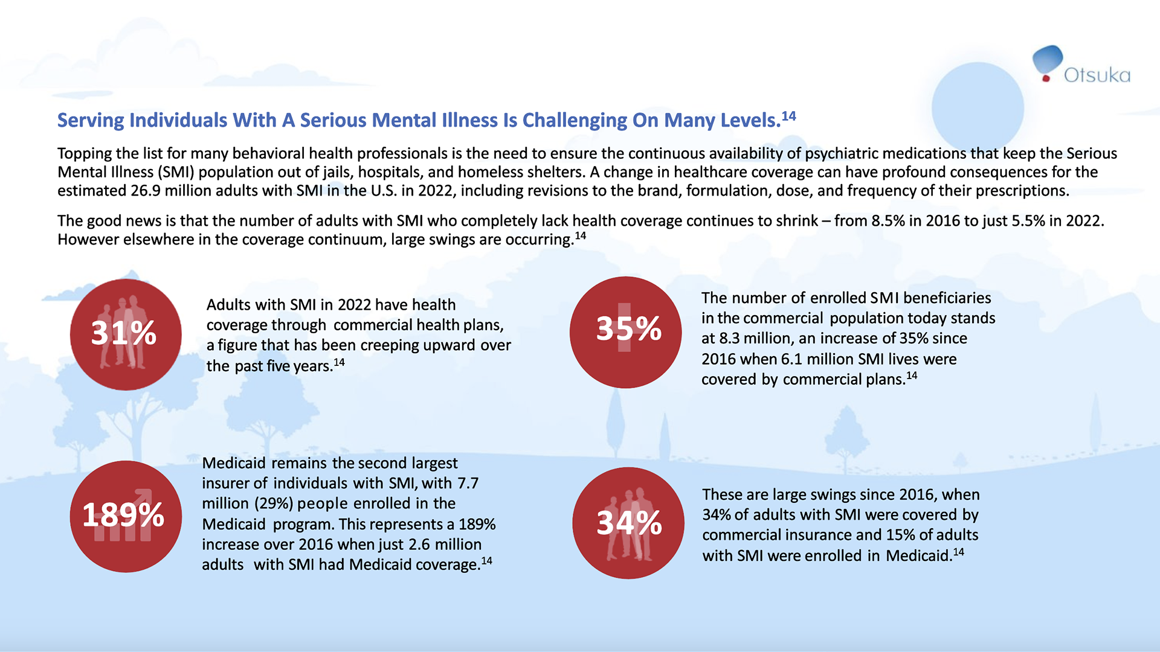

Slide 10
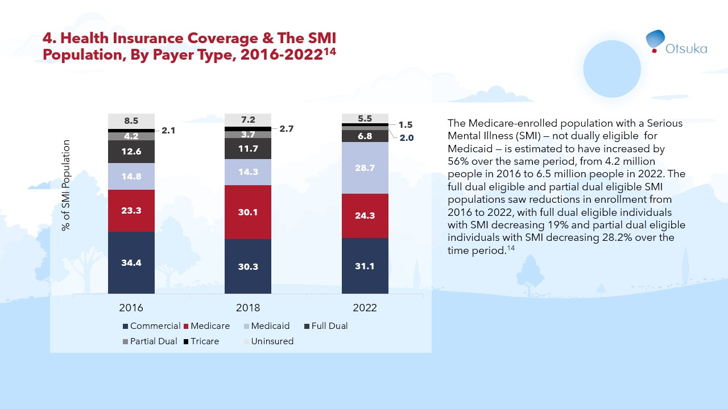

Slide 11
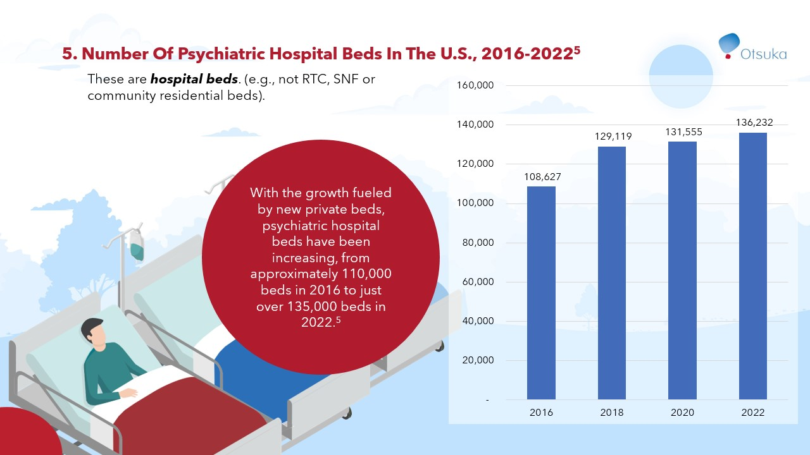

Slide 12
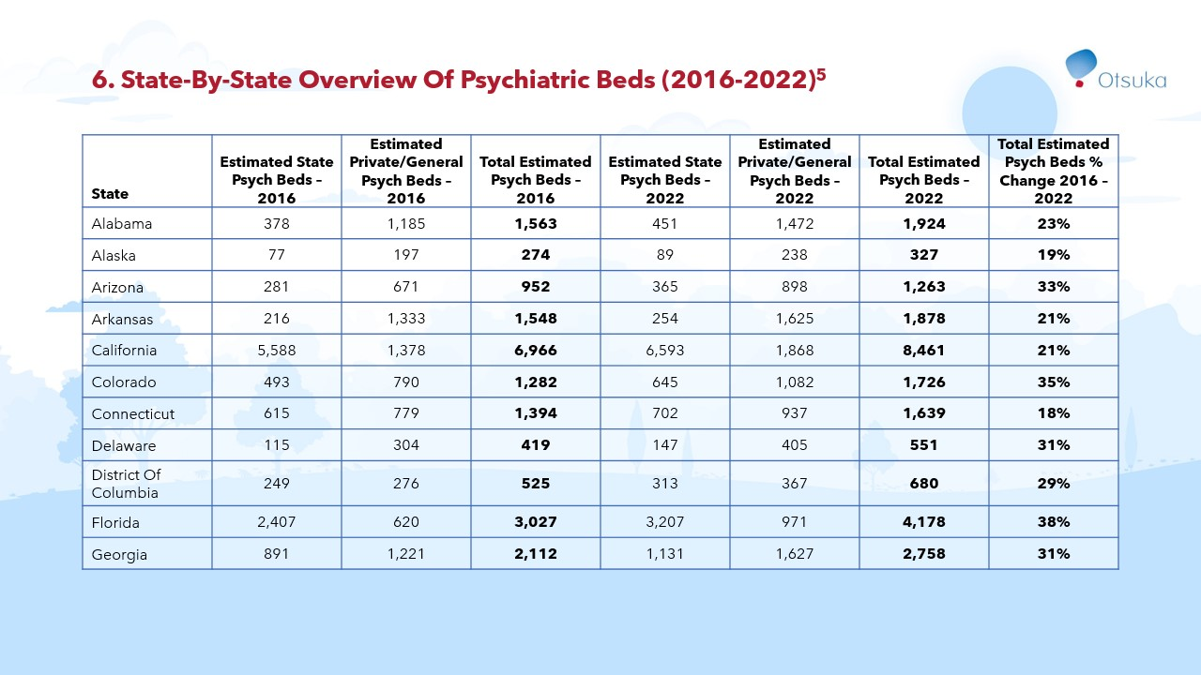

Slide 13
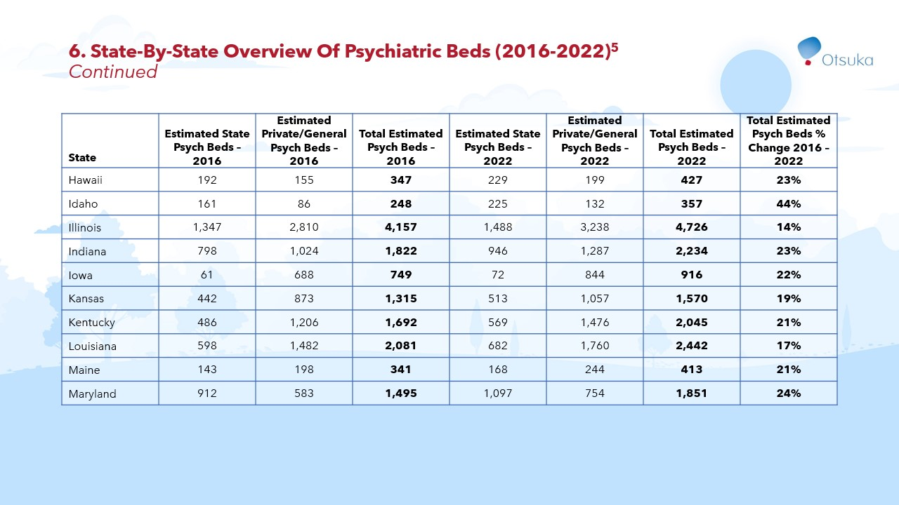

Slide 14
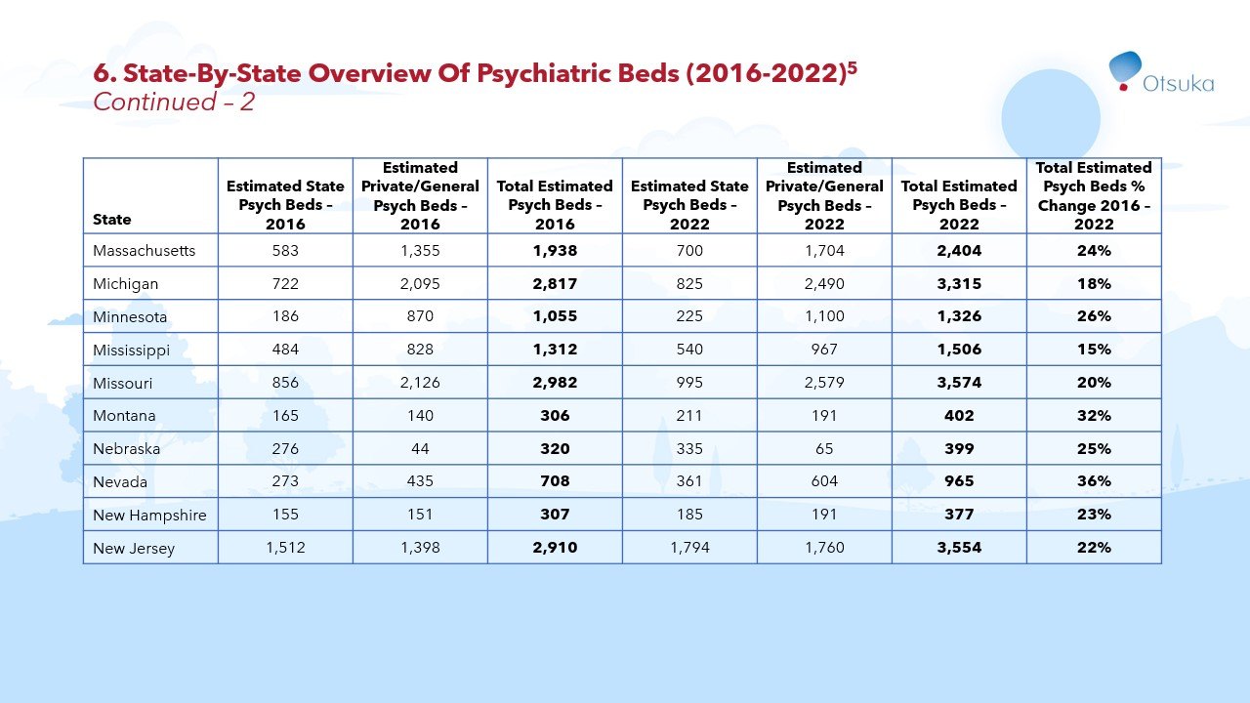

Slide 15
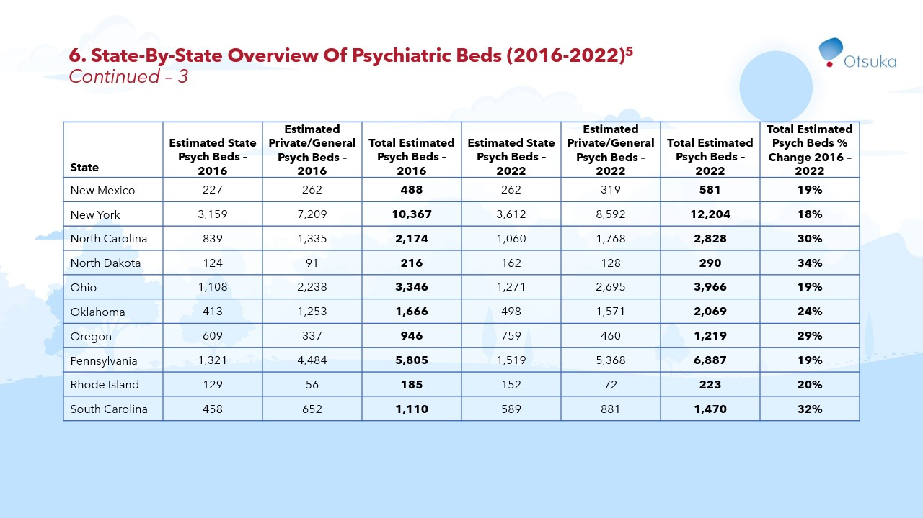

Slide 16


Slide 17
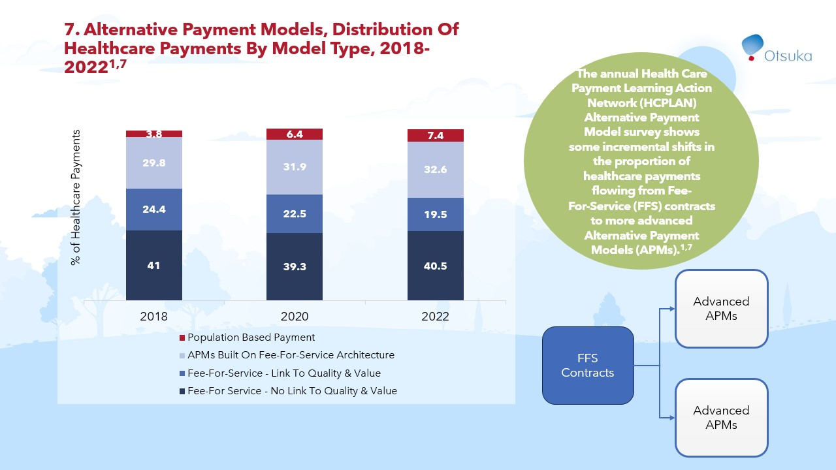

Slide 18
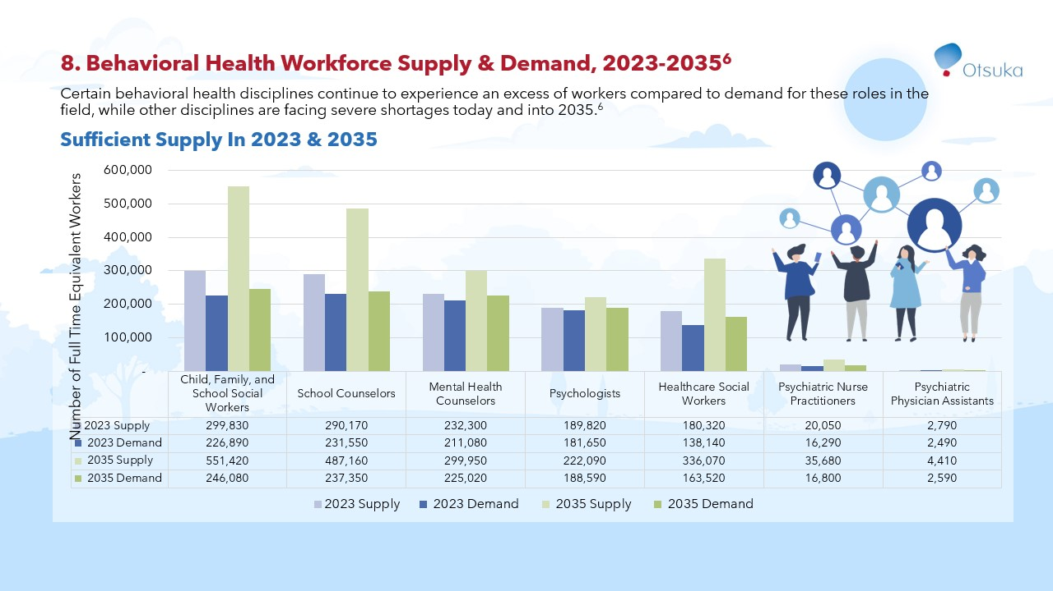

Slide 19
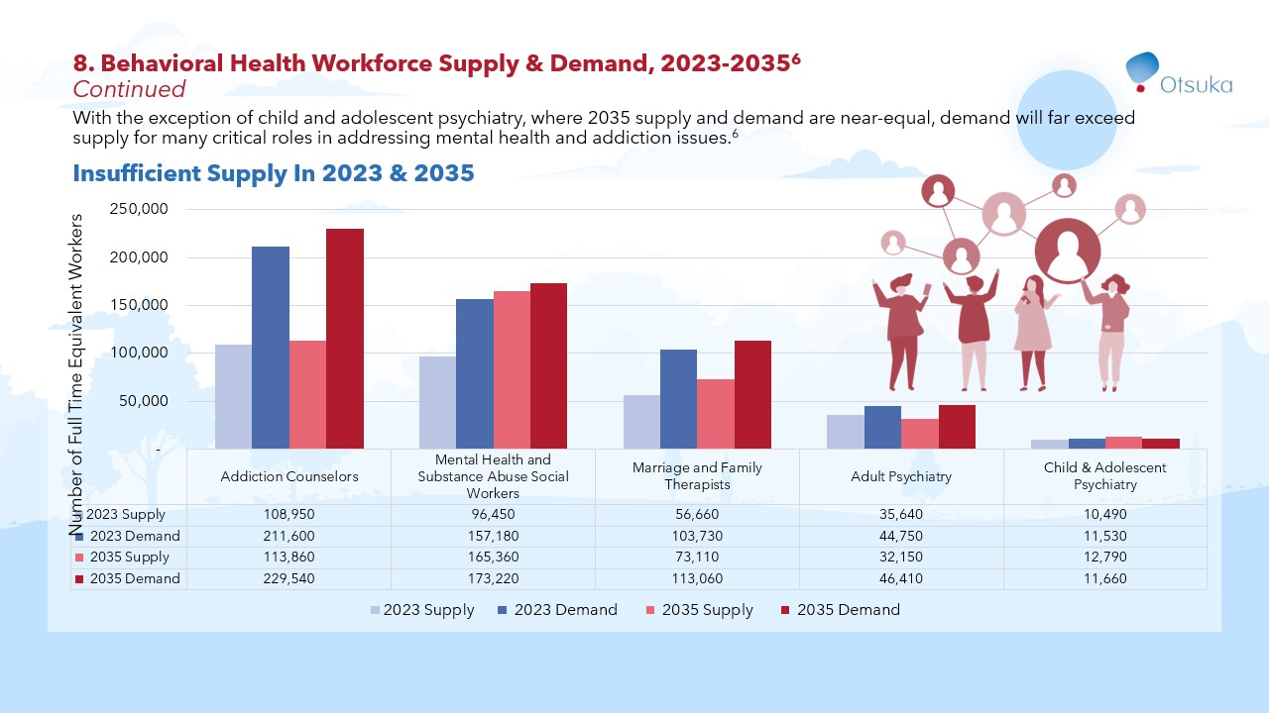

Slide 20
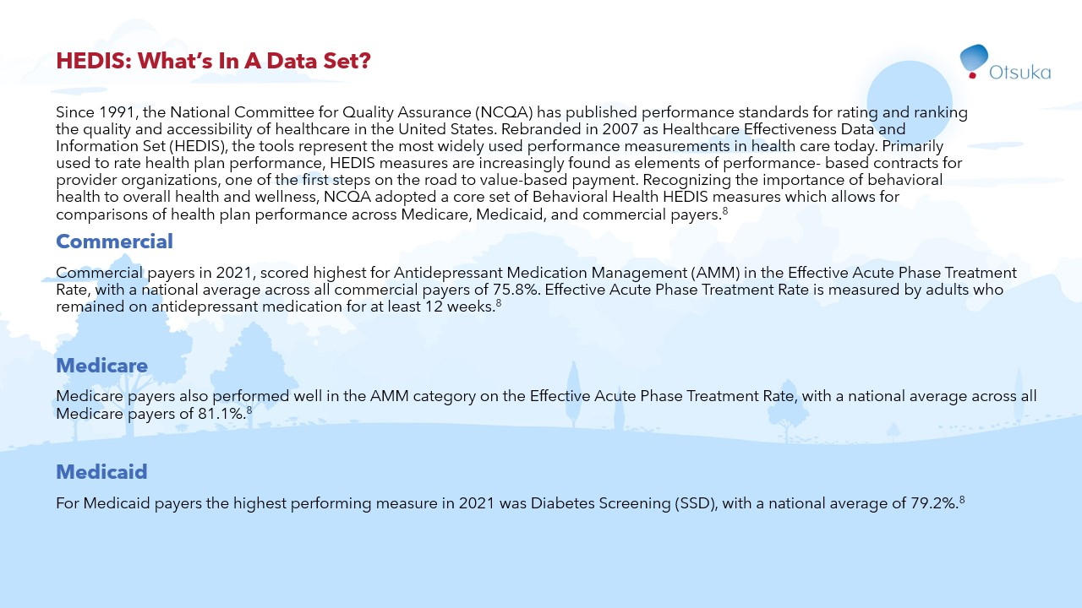

Slide 21
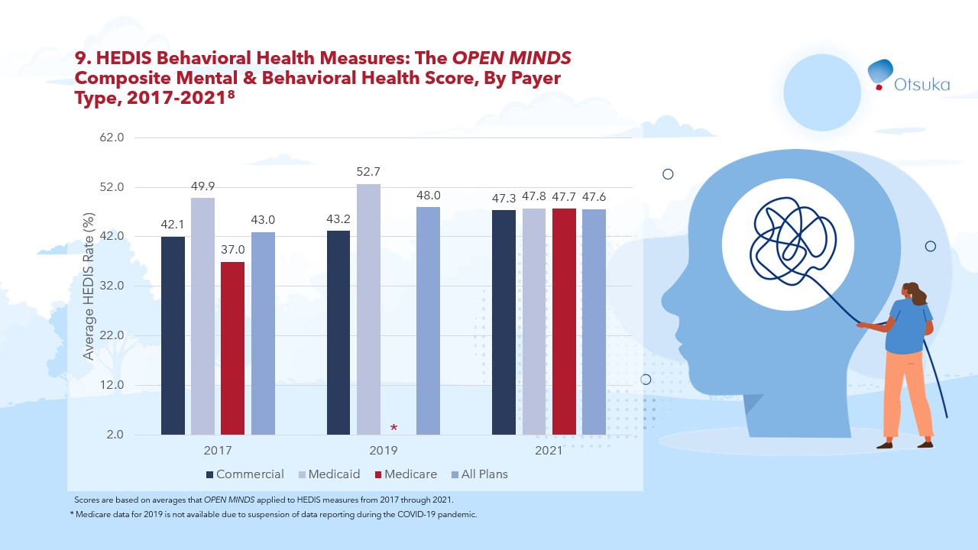

Slide 22
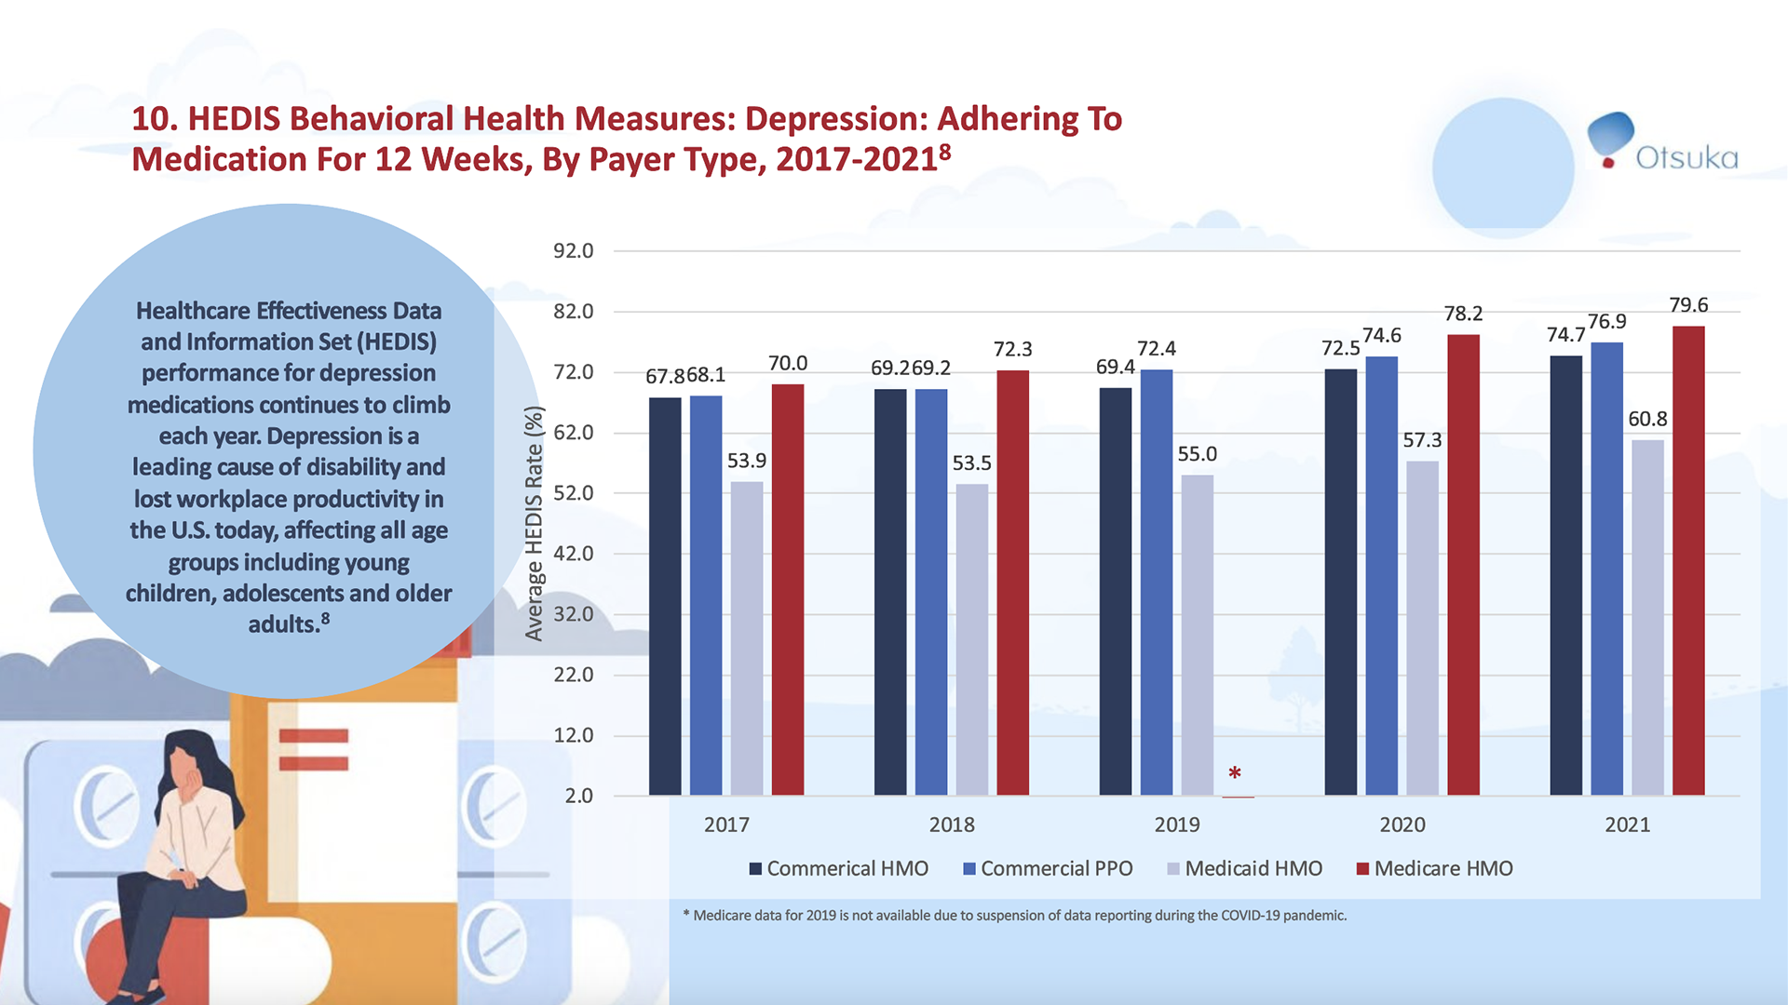

Slide 23
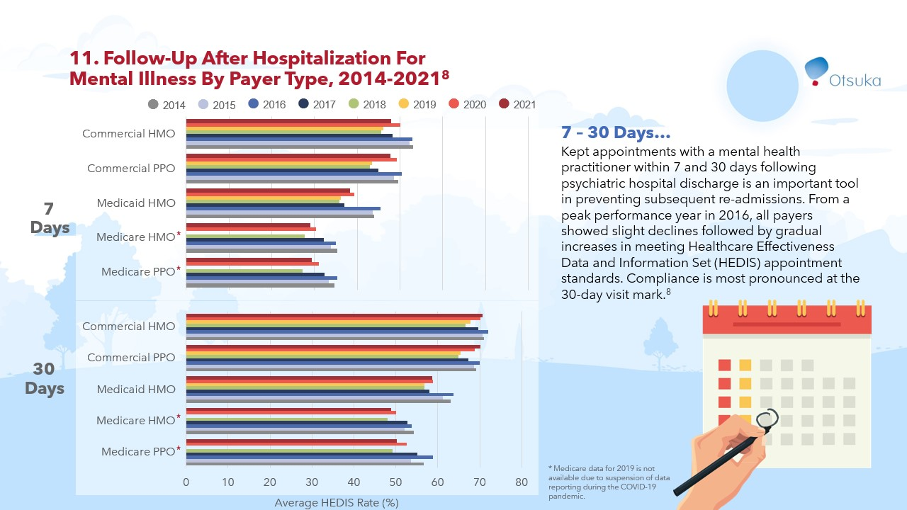

Slide 24
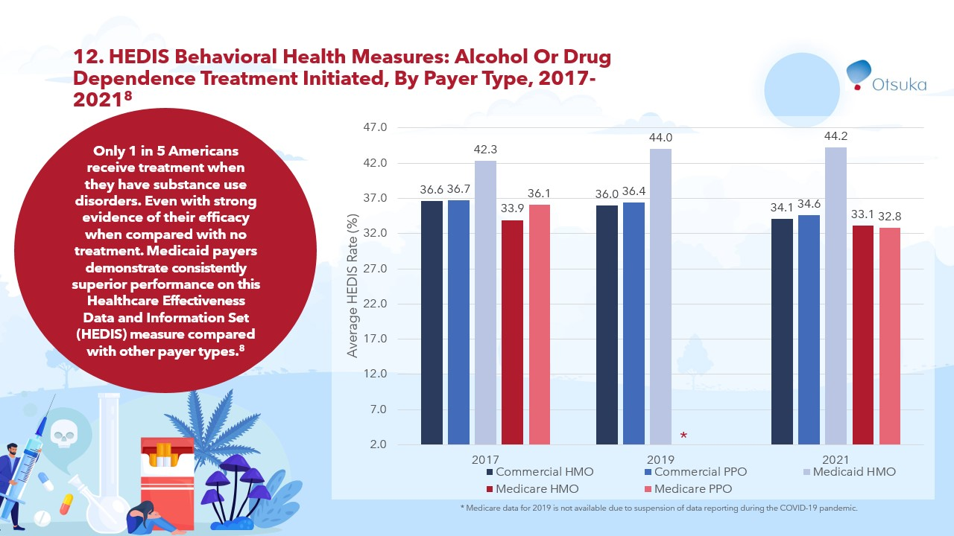

Slide 25
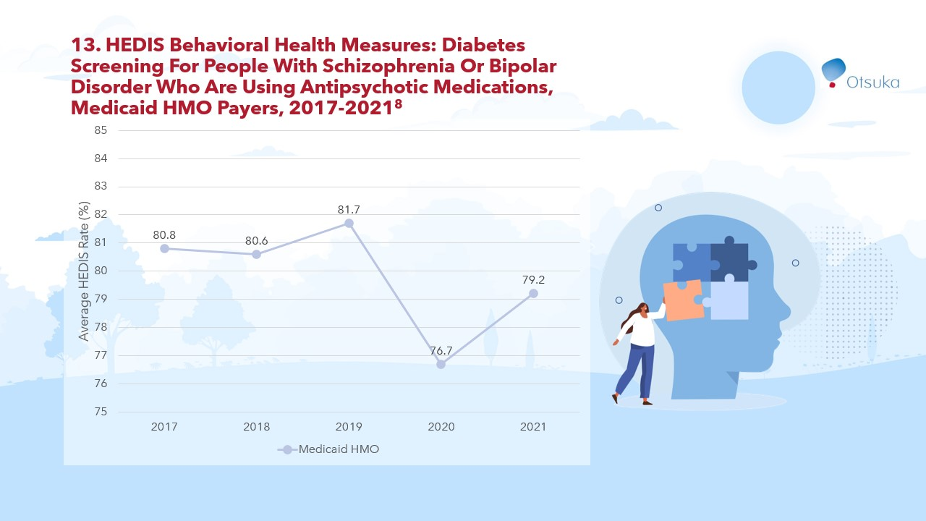

Slide 26
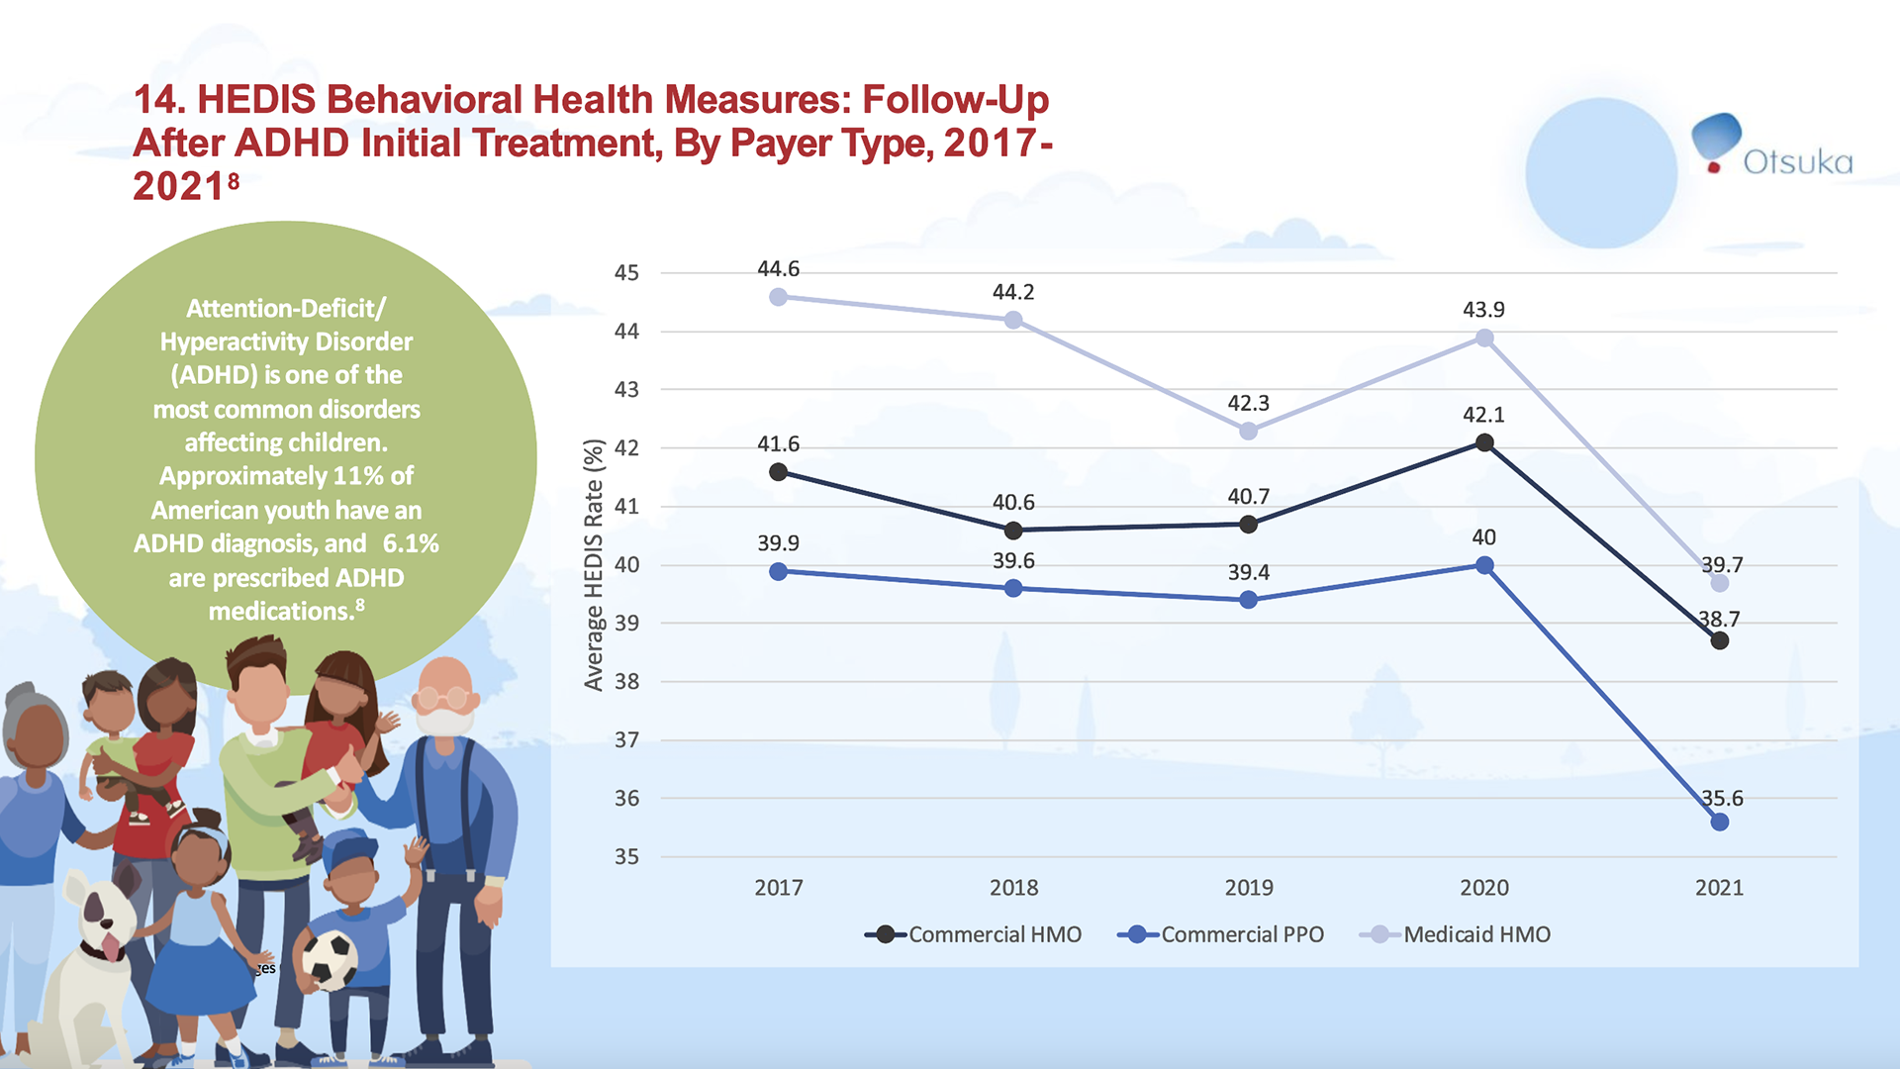

Slide 27
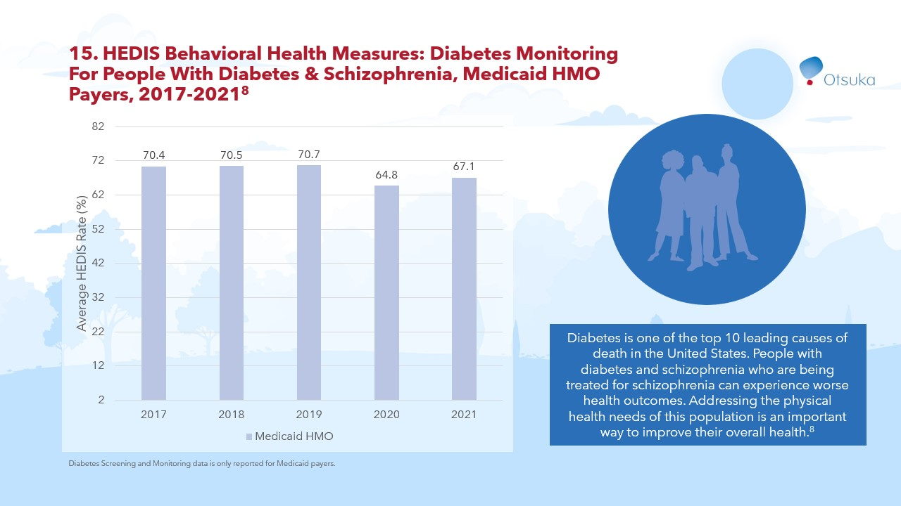

Slide 28
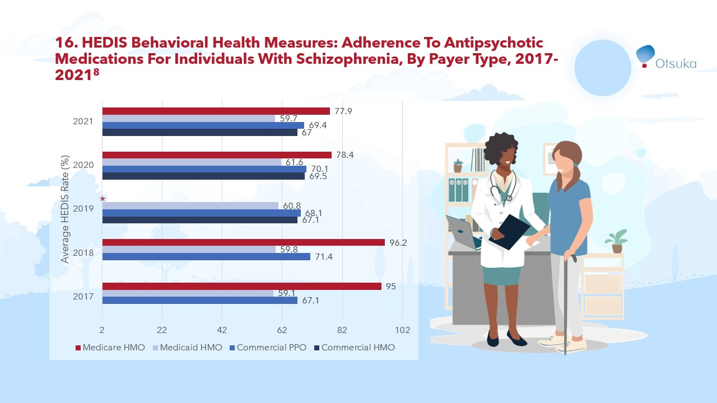

Slide 29
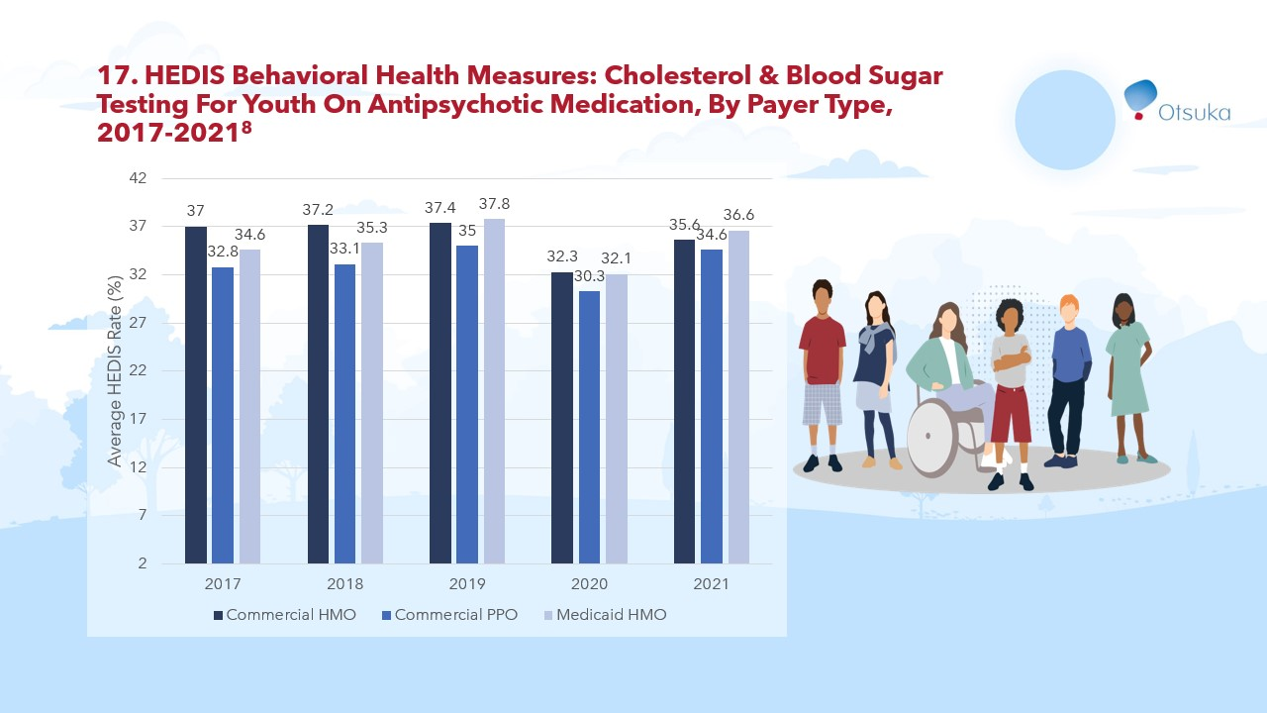

Slide 30
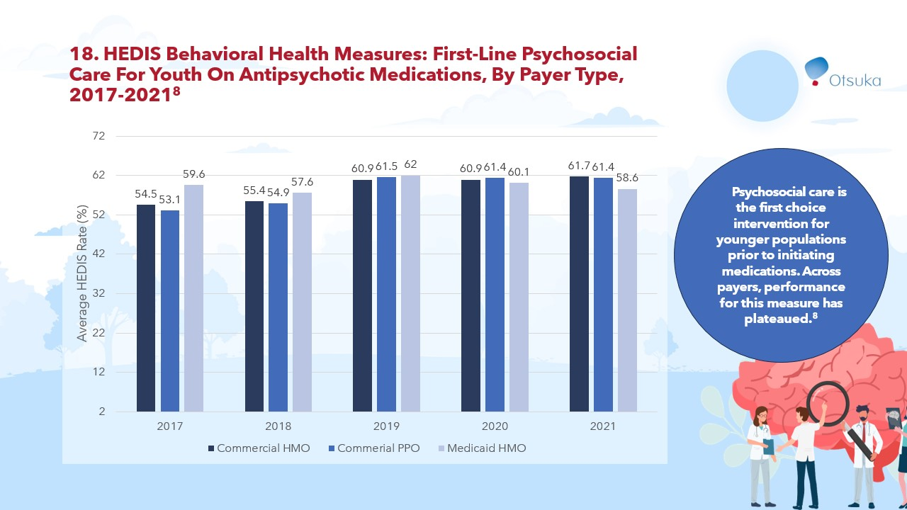

Slide 31
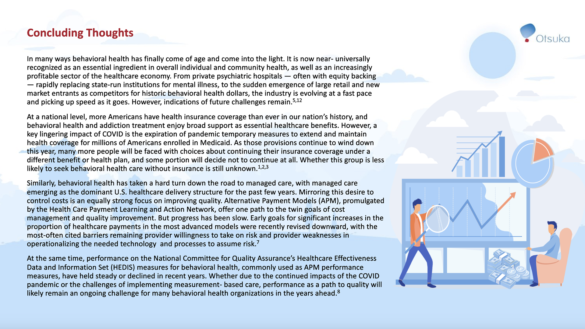

Slide 32
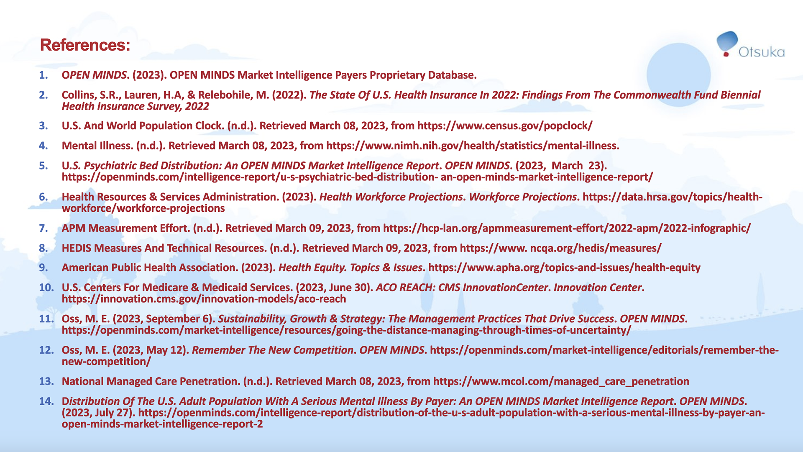

Slide 33


