Slide 1



©2023 Otsuka Pharmaceutical Development & Commercialization, Inc. All rights reserved. December 2023 00US23EUA0011
Notes:
©2023 Otsuka Pharmaceutical Development & Commercialization, Inc. All rights reserved.
December 2023 00US23EUA0011

Slide 2
Table Of Contents
Executive Summary
  The 2023 Survey On Health Plan Innovations In Behavioral Healthcare Service Delivery & Additional Research
  Percent Of Americans By Type Of Healthcare Coverage, 2018-2022
  Growth Of Managed Care As A Health Plan Business Model, 2017-2022
Quality
  The Rise Of Integrated Delivery Systems: Alignment Of Medicaid Financing For Behavioral Health, Physical Health & Pharmacy, 2019-2022
  Coordination Of Care Strategies For Complex Members – All Plans, 2023
  Coordination Of Care Strategies In Place For Complex Members – All Plans, 2019-2023
  Utilization Of Social Determinants Of Health Strategies – All Plans, 2023
  Social Determinants Of Health Strategies In Place – All Plans, 2019-2023
  Interest In Data Analytic Tools – All Plans, 2019-2023
  Utilization Of Digital Technology Strategies – All Plans, 2023
  Utilization Of Prescription Digital Therapeutics – All Plans, 2023
Cost
  U.S. Medicaid Behavioral Health Innovation Initiatives: Organizational Trends Over Time, 2012-2023
  Alternative Payment Models, Distribution Of Healthcare Payments By Model Type, 2018-2022
  Specialty & Primary Care Provider Organizations Participating In VBR Arrangements, By Market, 2023
  Specialty Provider Organizations Only Participating In VBR Arrangements, By VBR Type, 2023
Notes:
©2023 Otsuka Pharmaceutical Development & Commercialization, Inc. All rights reserved.
December 2023 00US23EUA0011

Slide 3

Table Of Contents Continued
Access To Care
  CMS CAHPS Ratings For Medicare Advantage & Part D Prescription Drug Plans, 2021-2024
  Trends Impacting Health Plan Management Access Decisions – All Plans, 2023
Vulnerable Populations
  Health Plan Perspectives On Unmet Needs For Behavioral Health Services – All Plans, 2023
  Health Plan Priorities In Behavioral Health Population Management – All Plans, 2023
  Health Plan Interest In Partnerships with BioPharmaceutical Companies – All Plans, 2023
Conclusion
References
Notes:
©2023 Otsuka Pharmaceutical Development & Commercialization, Inc. All rights reserved.
December 2023 00US23EUA0011

Slide 4


Slide 5
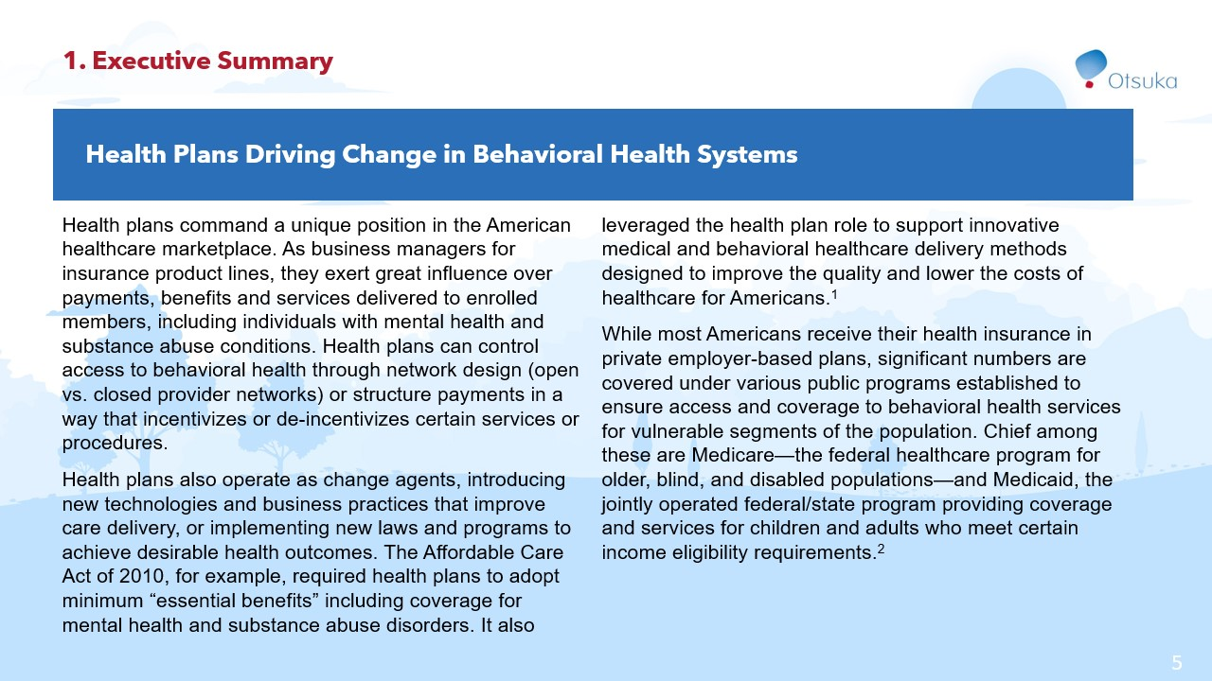

Slide 6
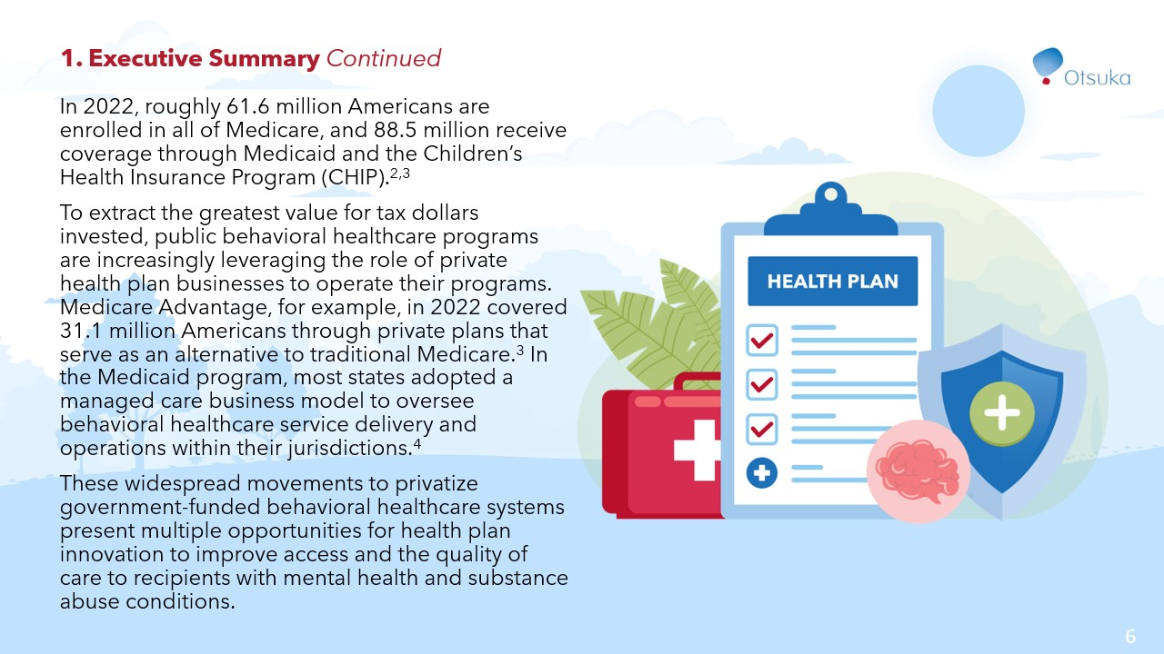

Slide 7
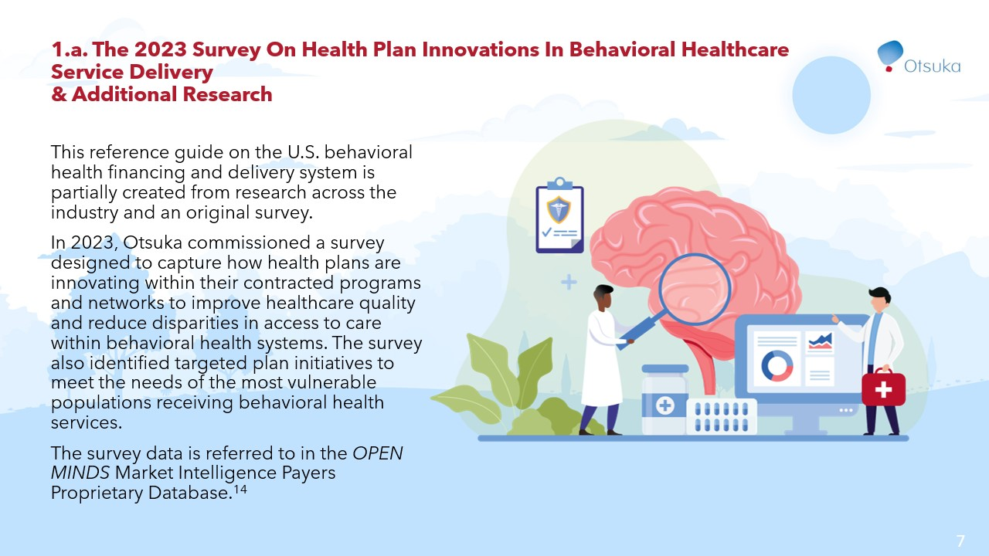

Slide 8
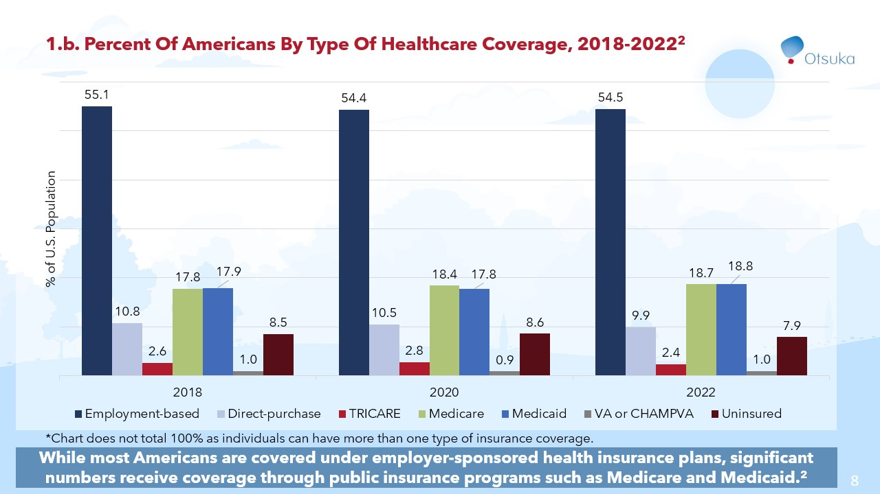

Slide 9
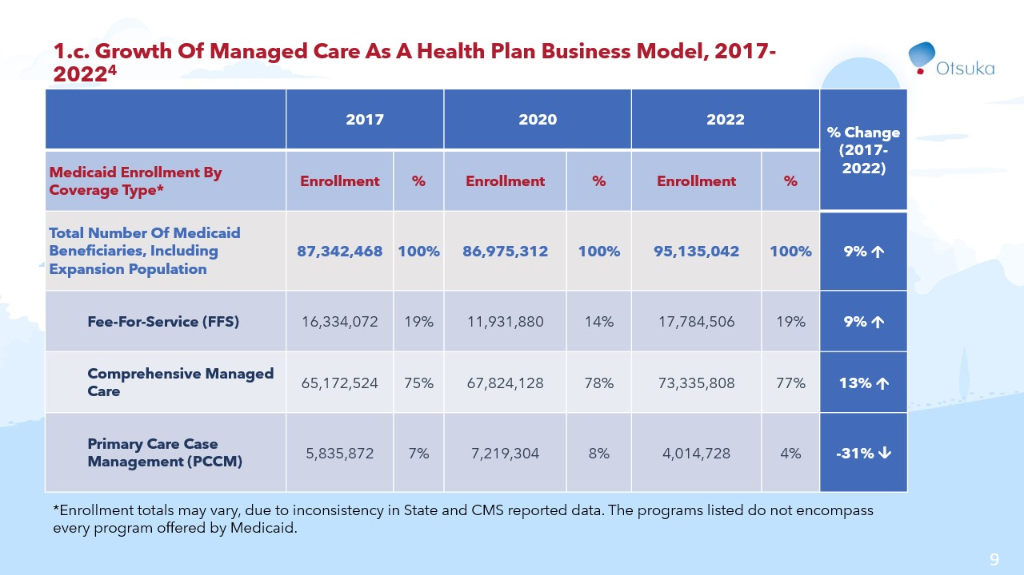

Slide 10
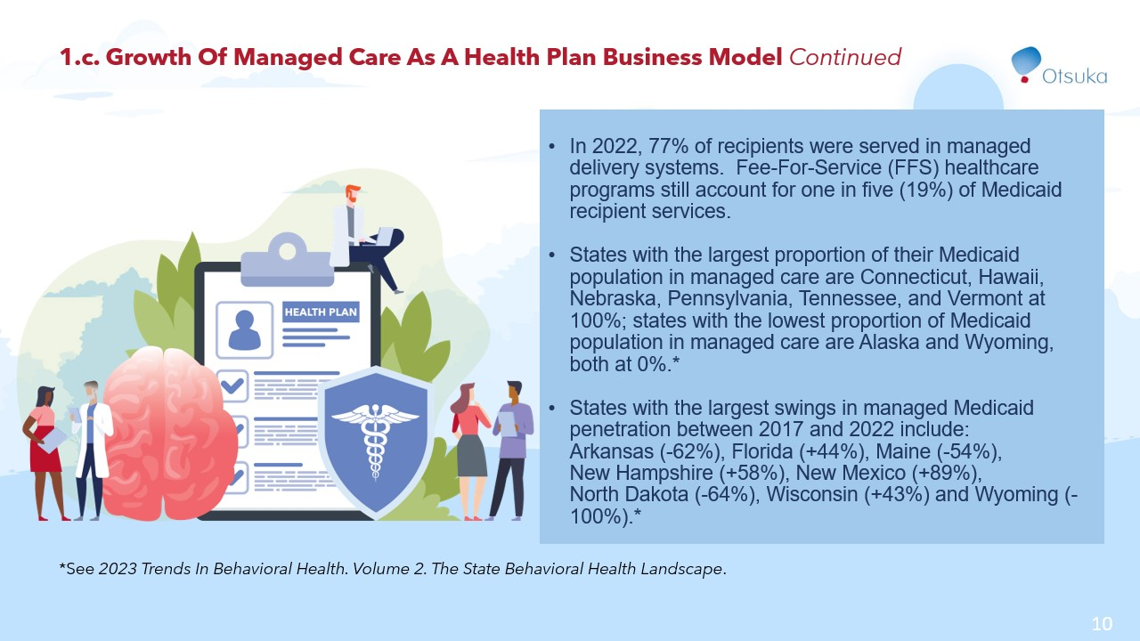

Slide 11


Slide 12
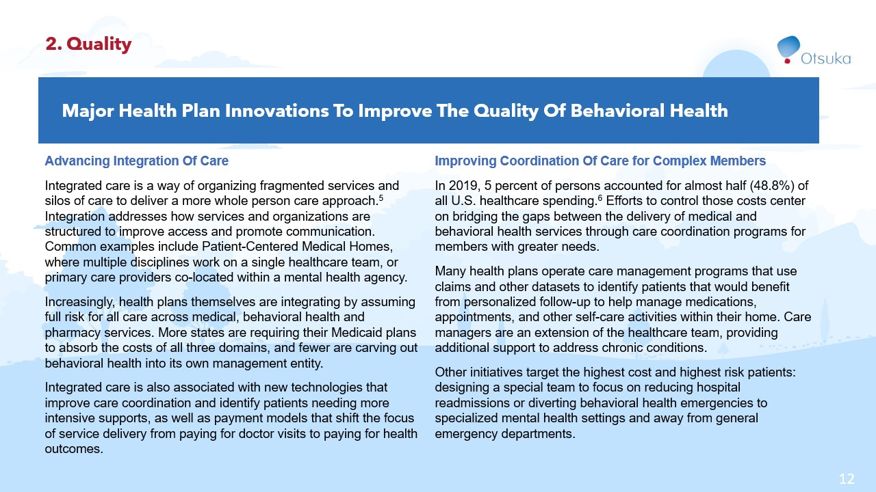

Slide 13
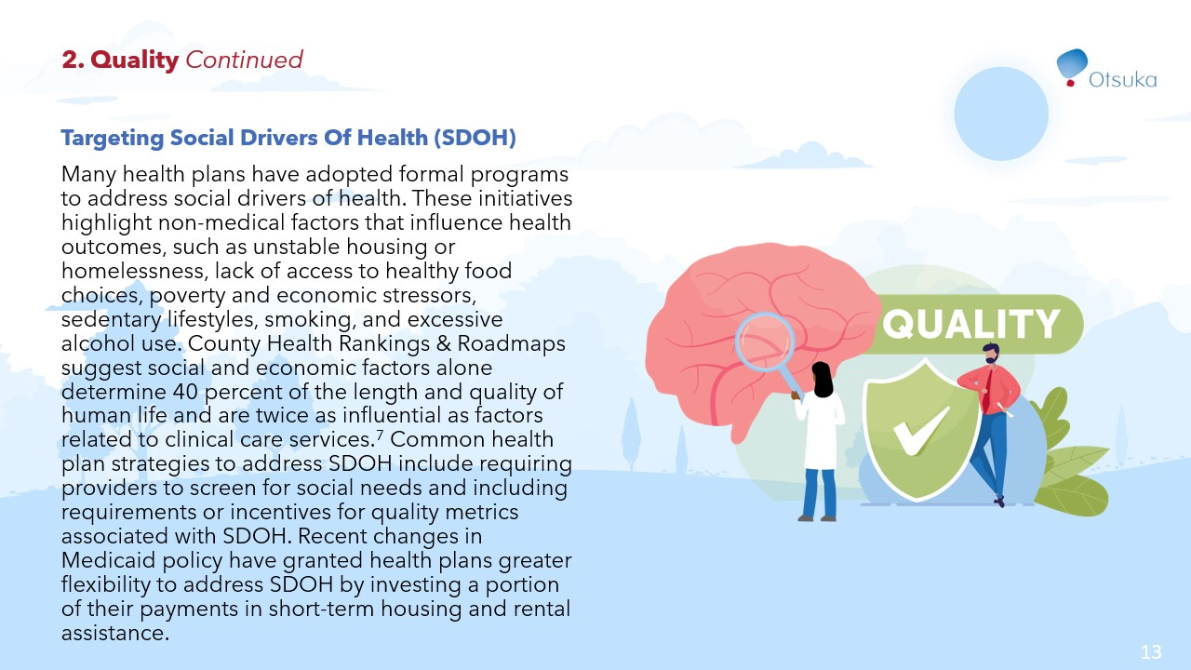

Slide 14
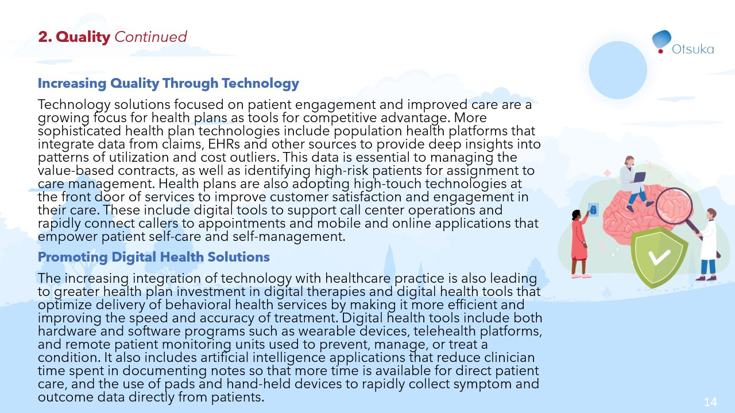

Slide 15
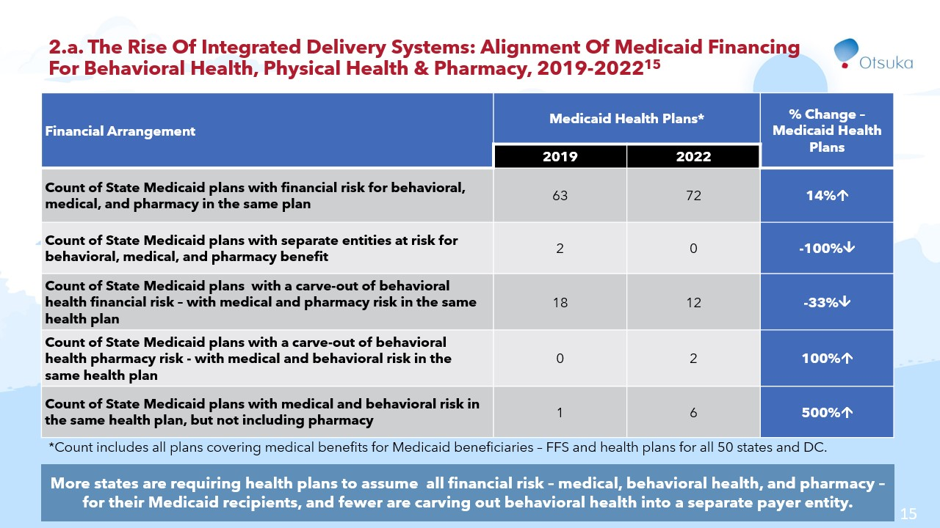

Slide 16
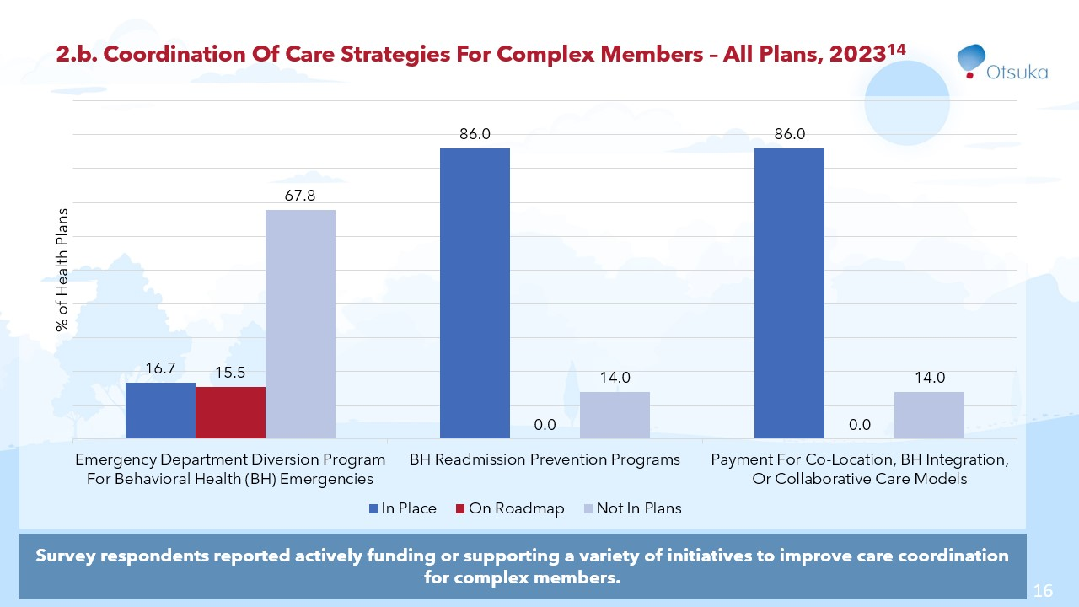

Slide 17
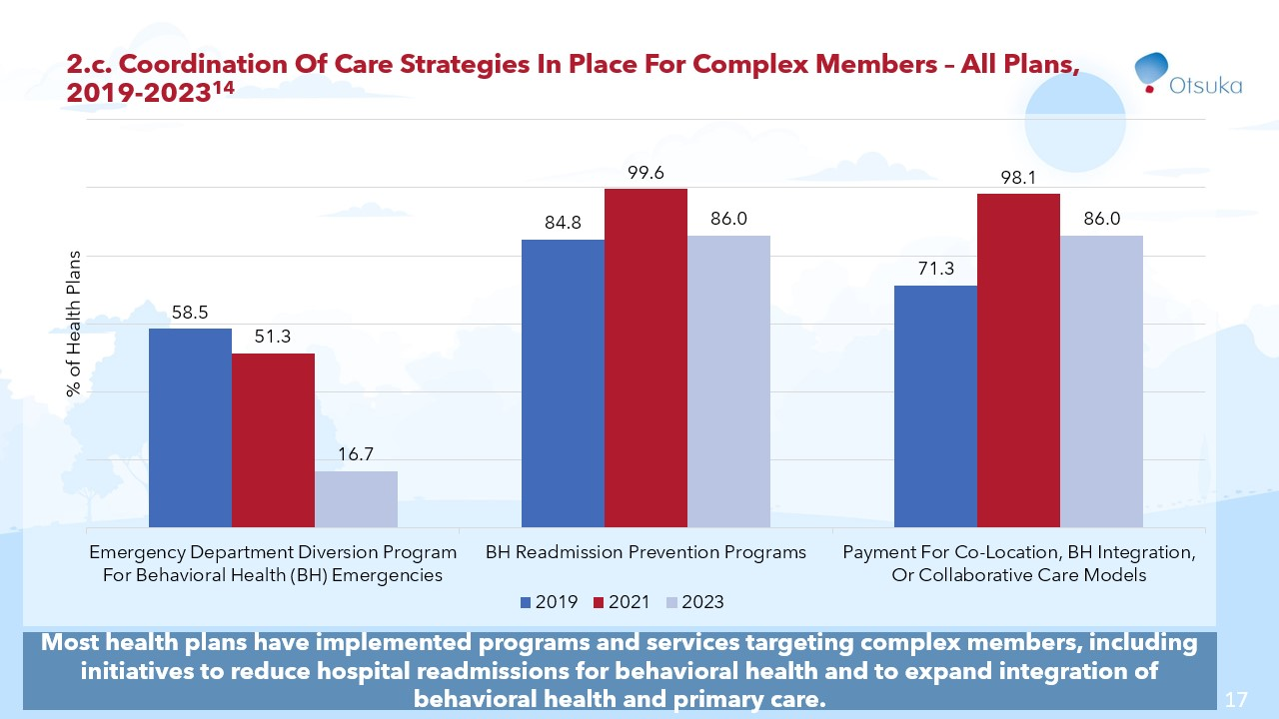

Slide 18
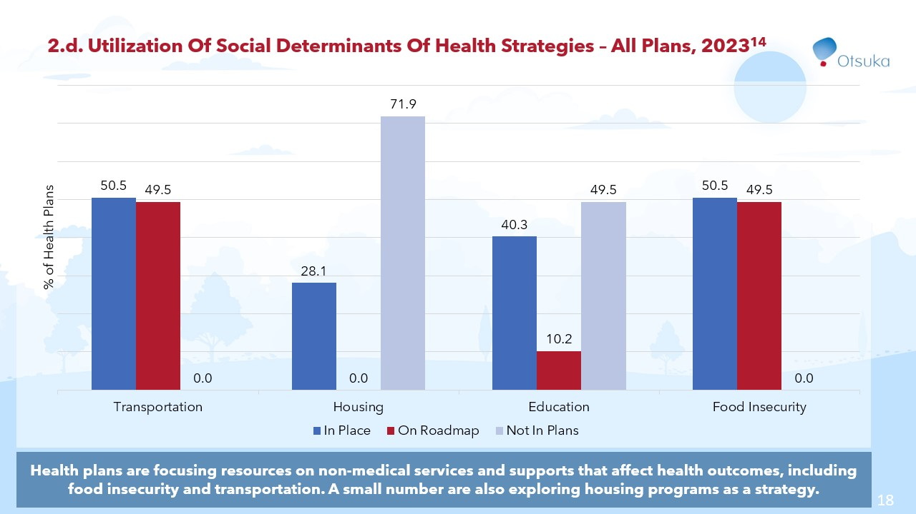

Slide 19
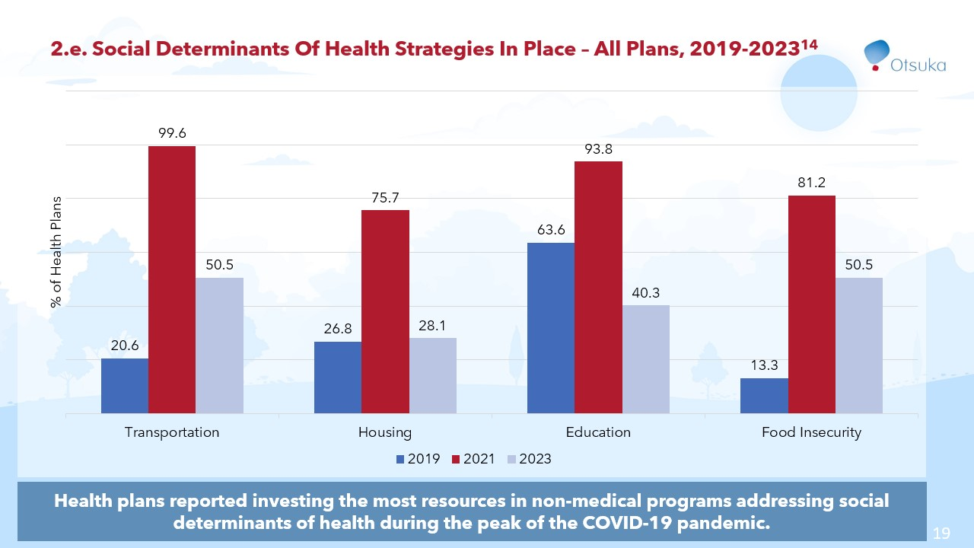

Slide 20
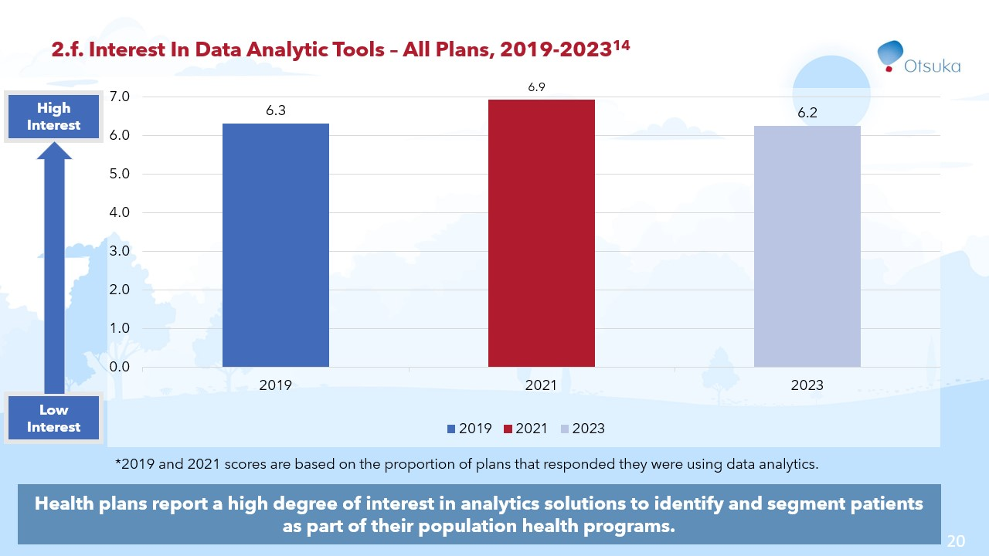

Slide 21
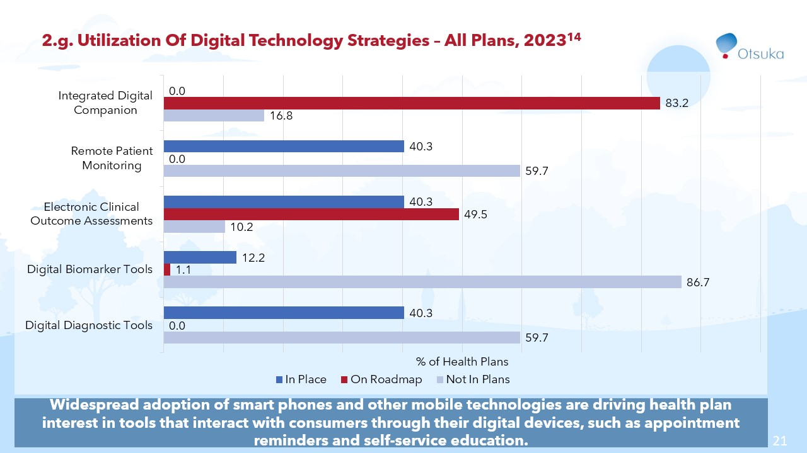

Slide 22
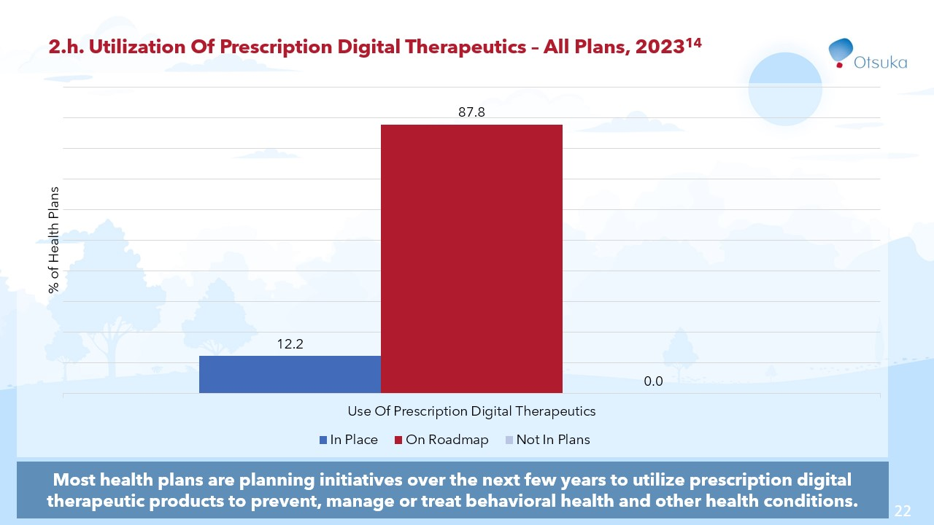

Slide 23


Slide 24
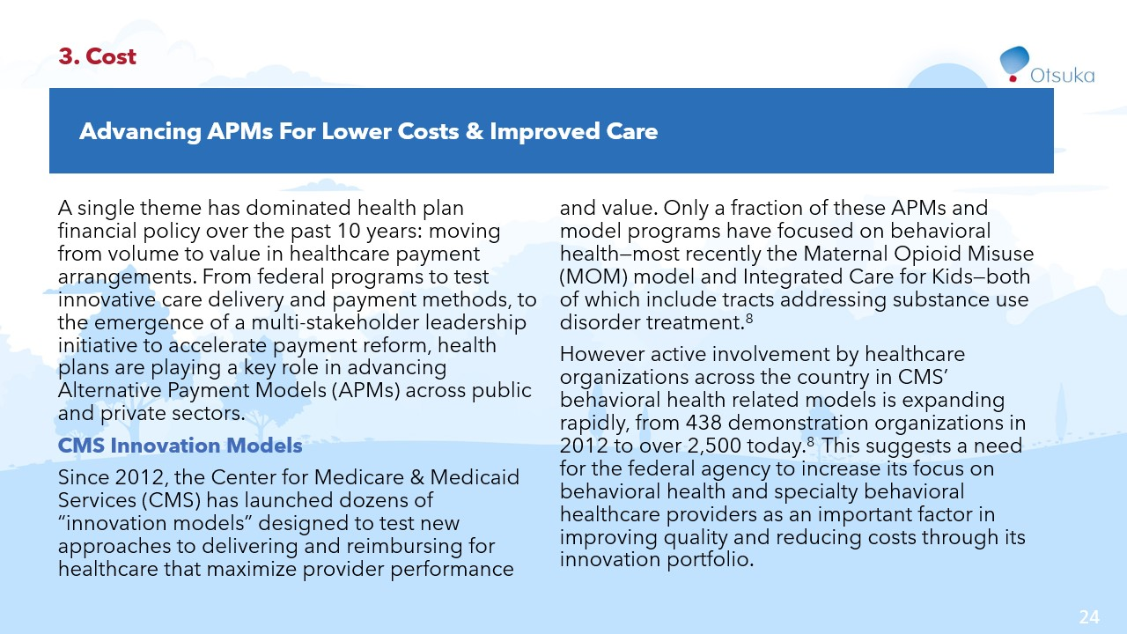

Slide 25
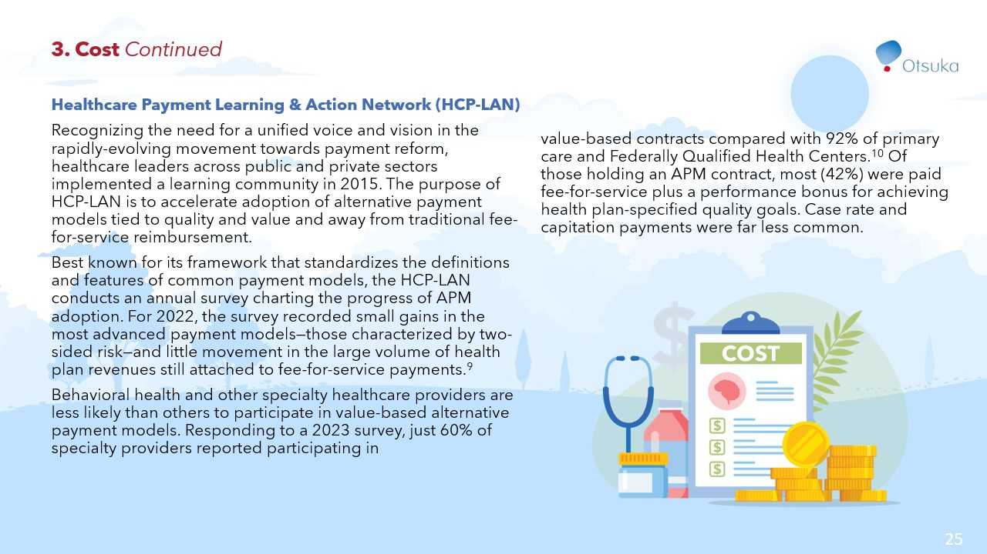

Slide 26
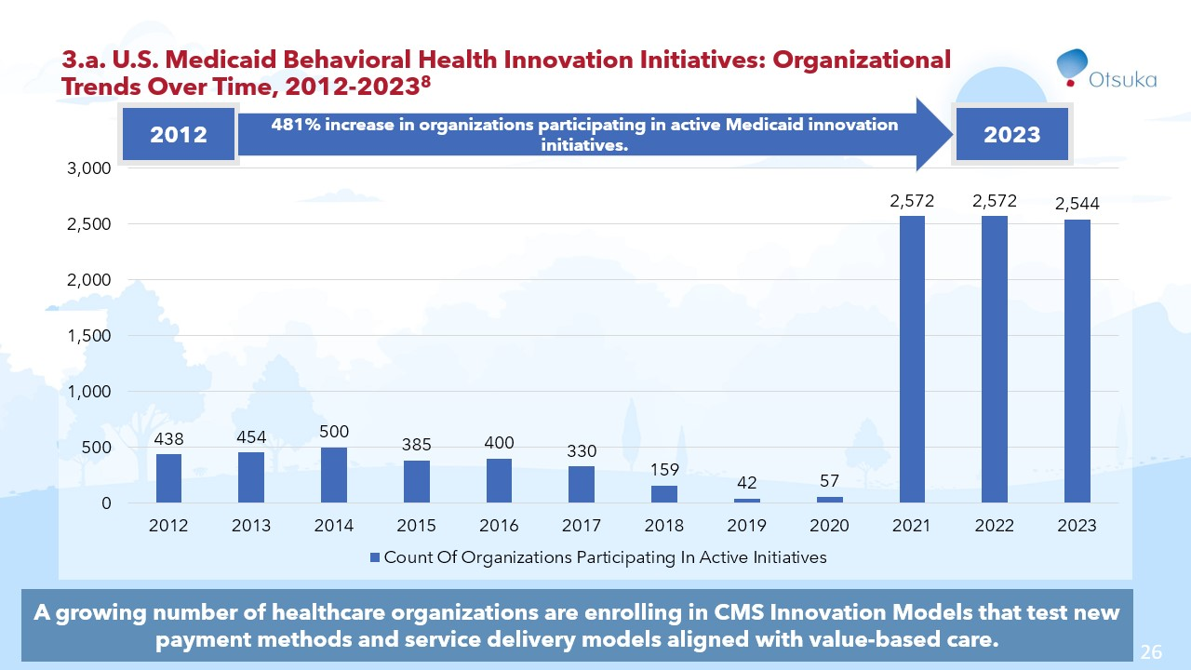

Slide 27
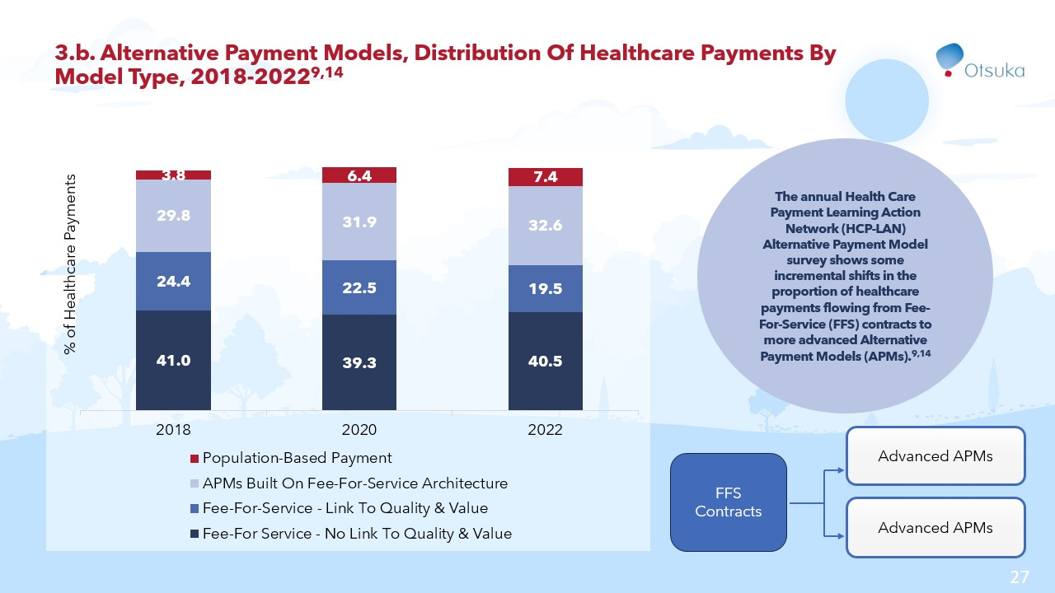

Slide 28
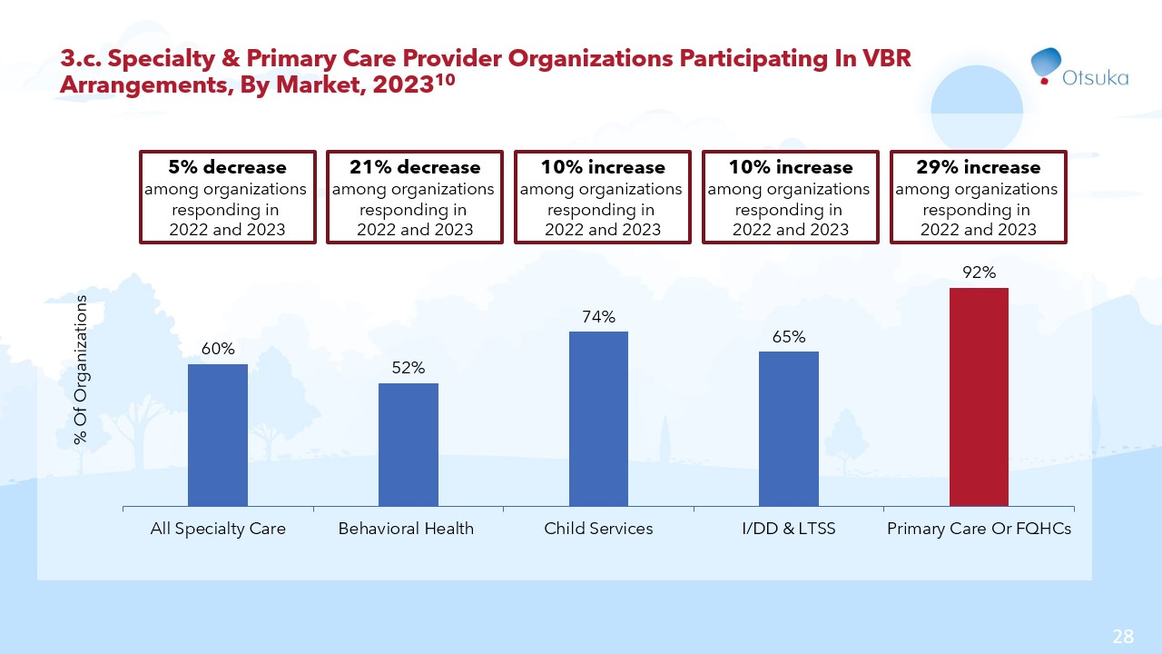

Slide 29
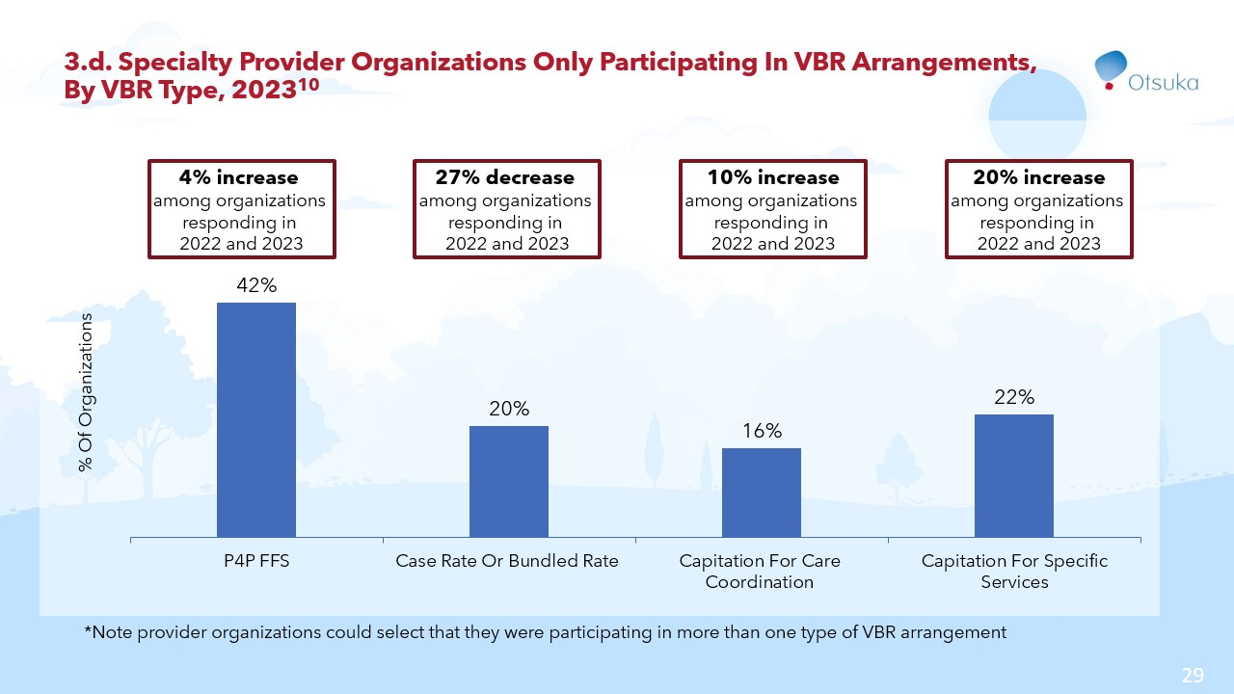

Slide 30


Slide 31
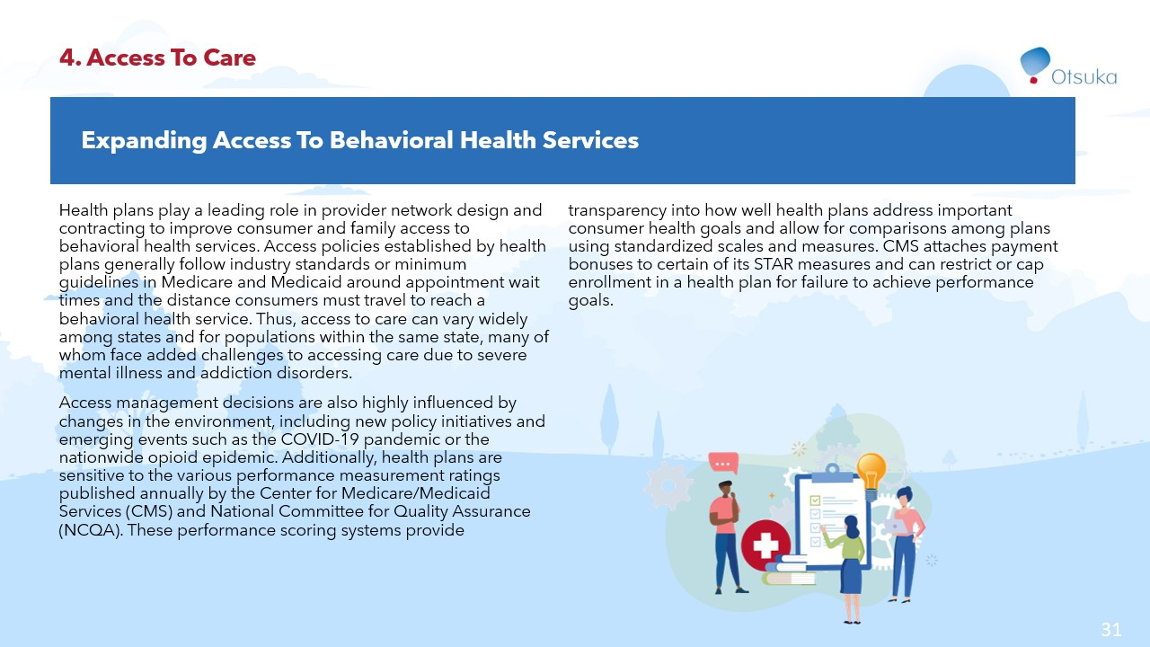

Slide 32
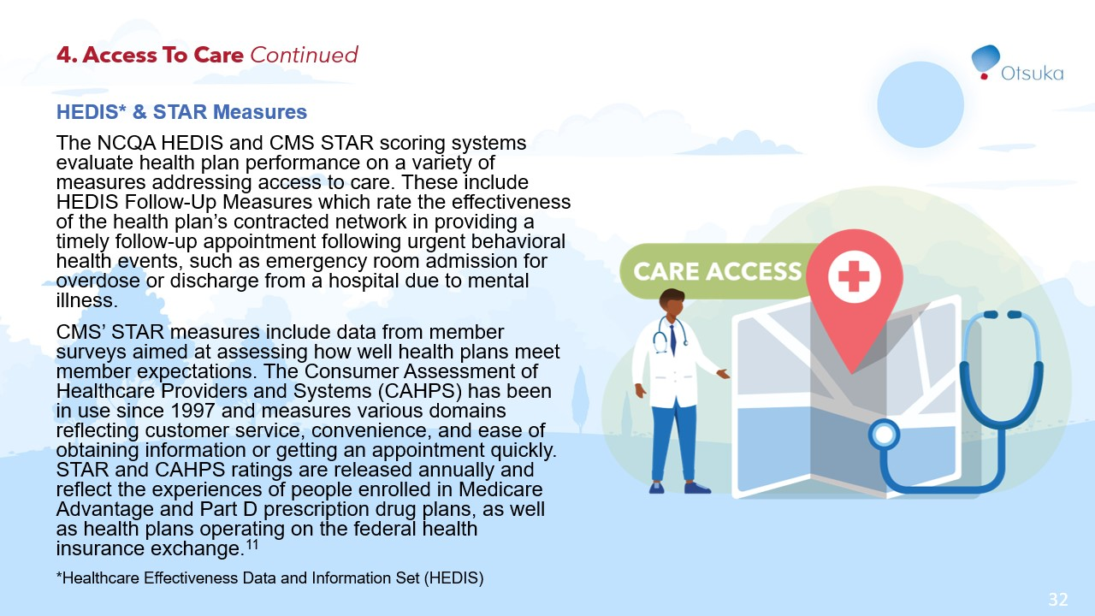

Slide 33
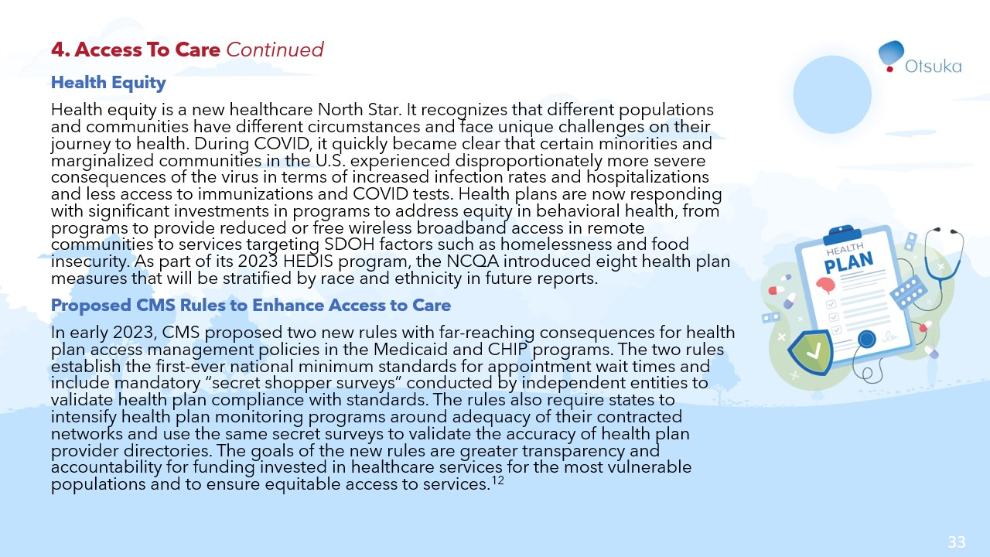

Slide 34
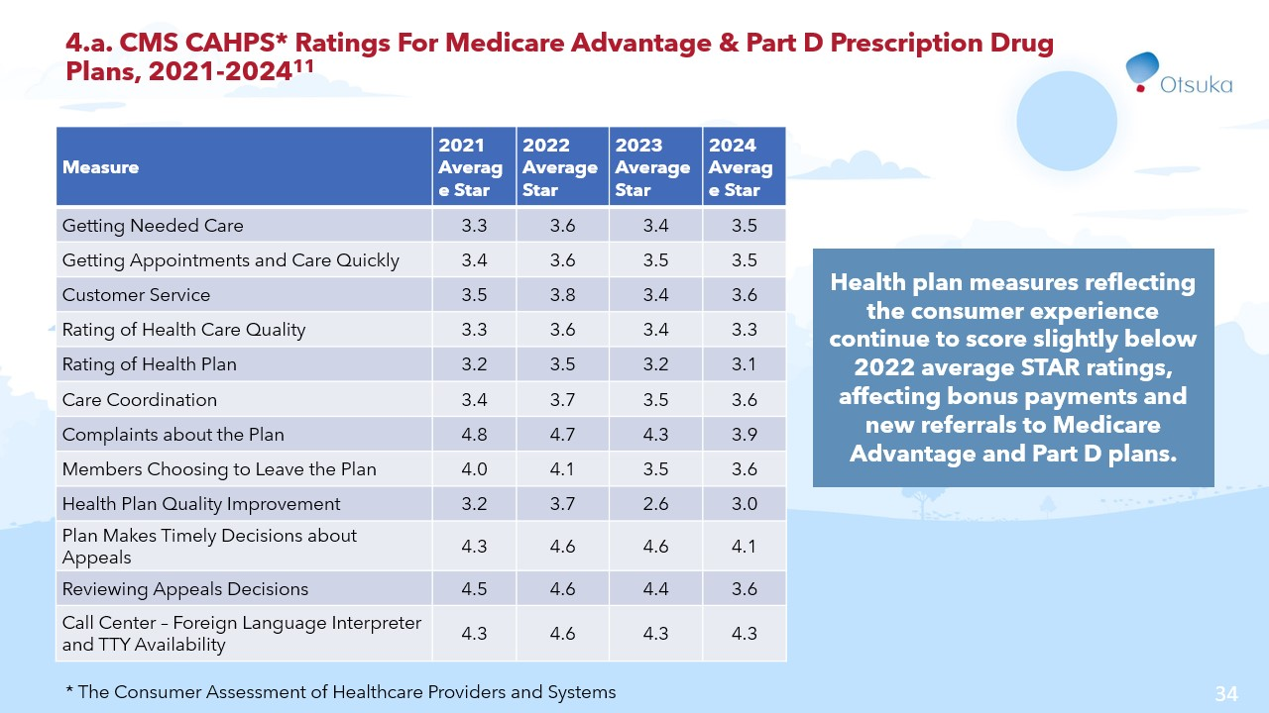

Slide 35
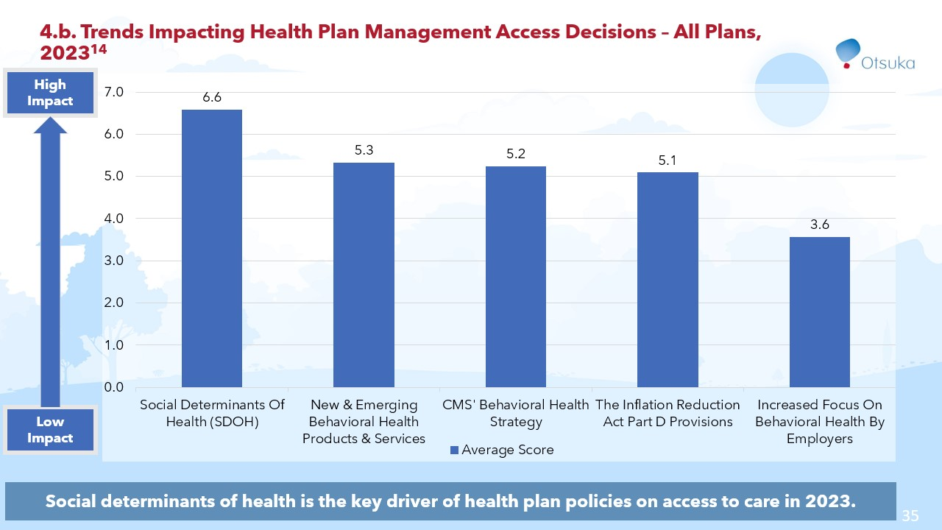

Slide 36


Slide 37
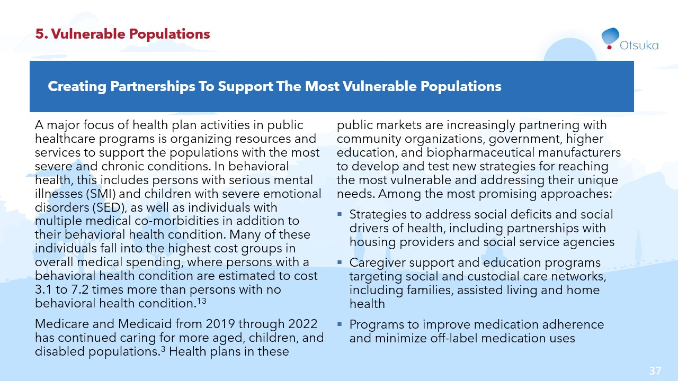

Slide 38
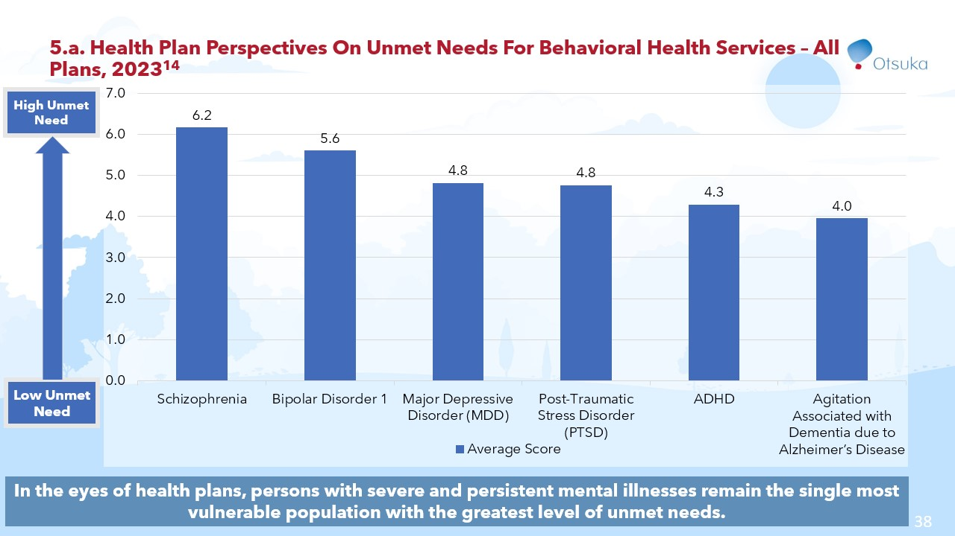

Slide 39
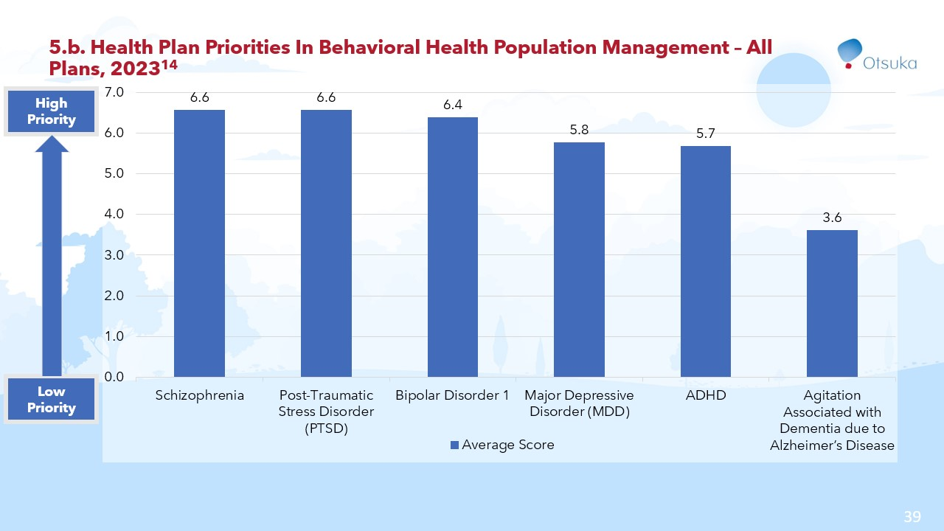

Slide 40
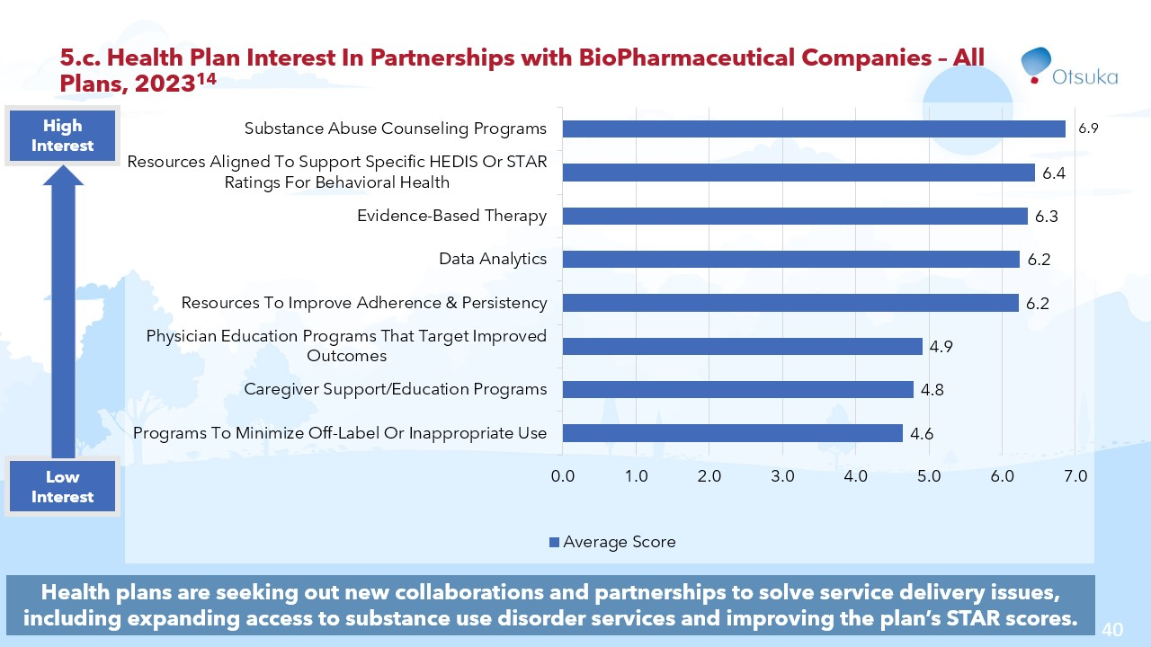

Slide 41


Slide 42
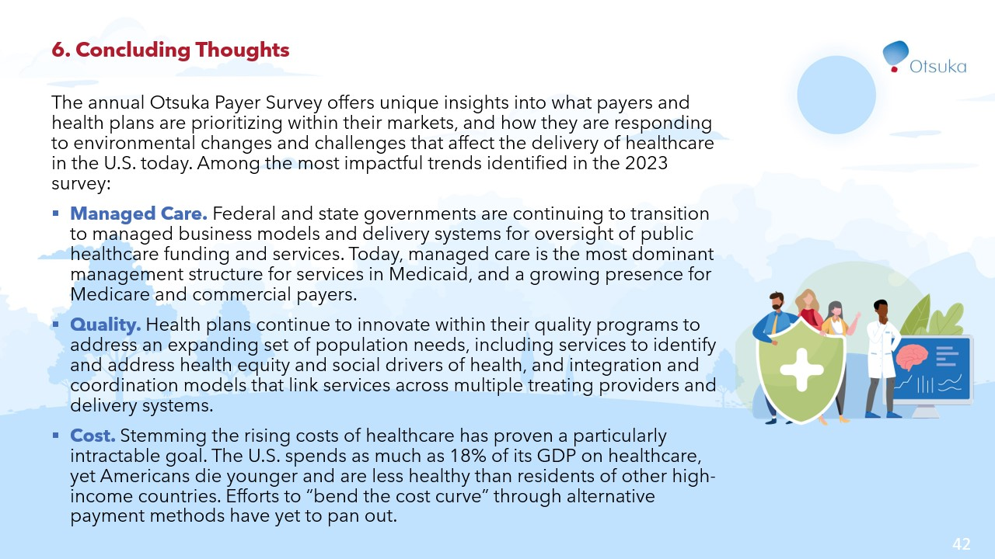

Slide 43
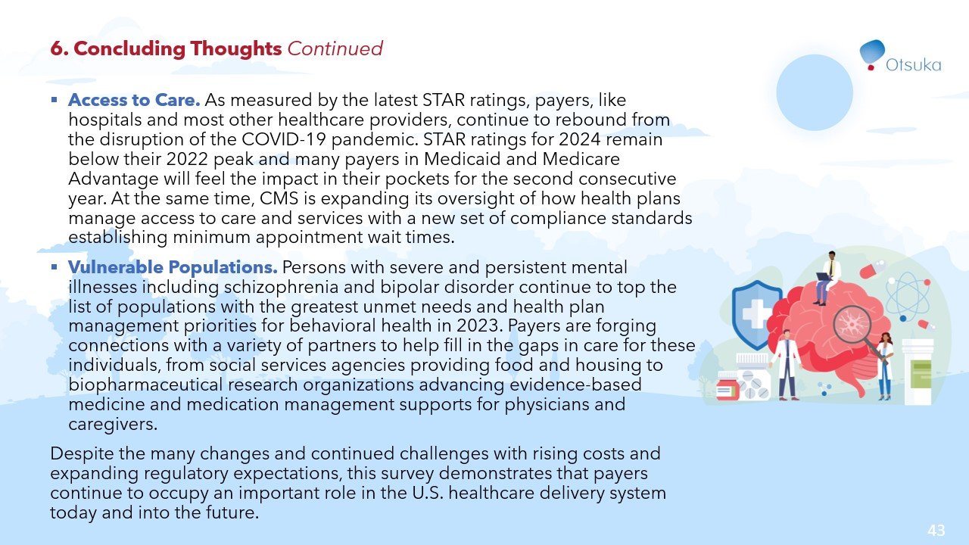

Slide 44
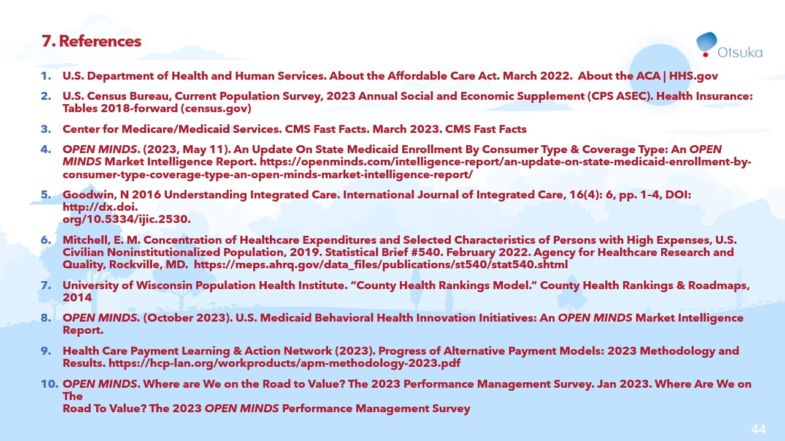

Slide 45
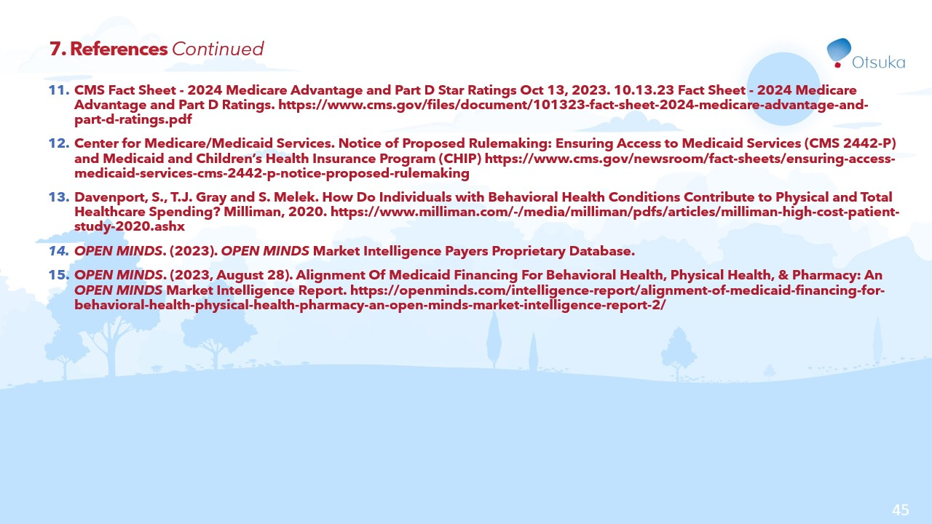

Slide 46


